Slide 1
Coal-fired power plants and industrial development
1st Berlin Applied Causal Graphs Workshop
Leonard Missbach

Slide 2
Industrializing economies invest heavily in coal

Slide 3
Why?
Coal has been favourable to industrial development in Europe.
What are direct and indirect causal effects of coal-fired power plants on local manufacturing firms?

Slide 4
A stylized causal graph
Coal investments
Industrial development

Slide 5
A stylized causal graph
Coal investments
Coal-fired power plant
Industrial development
Firm performance

Slide 6
Power plants might spill over to firms via several channels
Coal investments
Provision of electricity
Initial electricity access
Might become cheaper
Might become more reliable
Might be of higher „quality“
Coal-fired power plant
Electricity
Industrial development
Firm performance

Slide 7
Power plants might spill over to firms via several channels
Coal investments
Provision of electricity
Development of transport infrastructure
Coal requires roads, harbours or railways
Lowering transport costs for firms
Better access to labour markets
Better access to local goods and services
Coal-fired power plant
Electricity
Infrastructure
Industrial development
Firm performance

Slide 8
Power plants might spill over to firms via several channels
Coal investments
Provision of electricity
Development of transport infrastructure
Agglomeration effects
Increased firm turnover
Competition for inputs and labour
Knowledge spillovers, network effects
Coal-fired power plant
Electricity
Infrastructure
Agglomeration
Industrial development
Firm performance

Slide 9
Power plants might spill over to firms via several channels
Coal investments
Provision of electricity
Development of transport infrastructure
Agglomeration effects
Local labour markets
Increase in wages and immigration
Pollution and emigration
Coal-fired power plant
Electricity
Infrastructure
Agglomeration
Labour
Industrial development
Firm performance

Slide 10
Power plants might affect firms through several channels
Coal investments
Provision of electricity
Development of transport infrastructure
Agglomeration effects
Local labour markets
Coal-fired power plant
Electricity
Infrastructure
Agglomeration
Labour
Industrial development
Firm performance

Slide 11
Credible identification is challenging
Coal-fired power plant
Endogeneity of treatment
Staggered treatment
Repeating treatments to single firms
Potential source of bias
Different channels
Time
Technology / Industry
Space
Regional development programs, price reforms
Endowment, expectations, capability
Firm performance

Slide 12
Method: Stacked Difference-in-Differences
Firm-year-level data from Indonesian Manufacturing Census
Create a dataset (cohort) for each year with a treatment $θ$
Include firms that are eligible for treatment and control group, e.g.
Exclude firms from treatment group, if they were treated in the past three years
Exclude firms from control group, if they were never treated
Stack datasets and study difference-in-differences
1st difference: treatment vs. control group
2nd difference: pre-treatment vs. post-treatment period
$${θ }_{1}$$
$${θ }_{1}$$
$$η_{d}=1$$
$$η_{d}=0$$
$${θ }_{1}$$
$${θ }_{2}$$
$${θ }_{3}$$
$${θ }_{n}$$

Slide 13
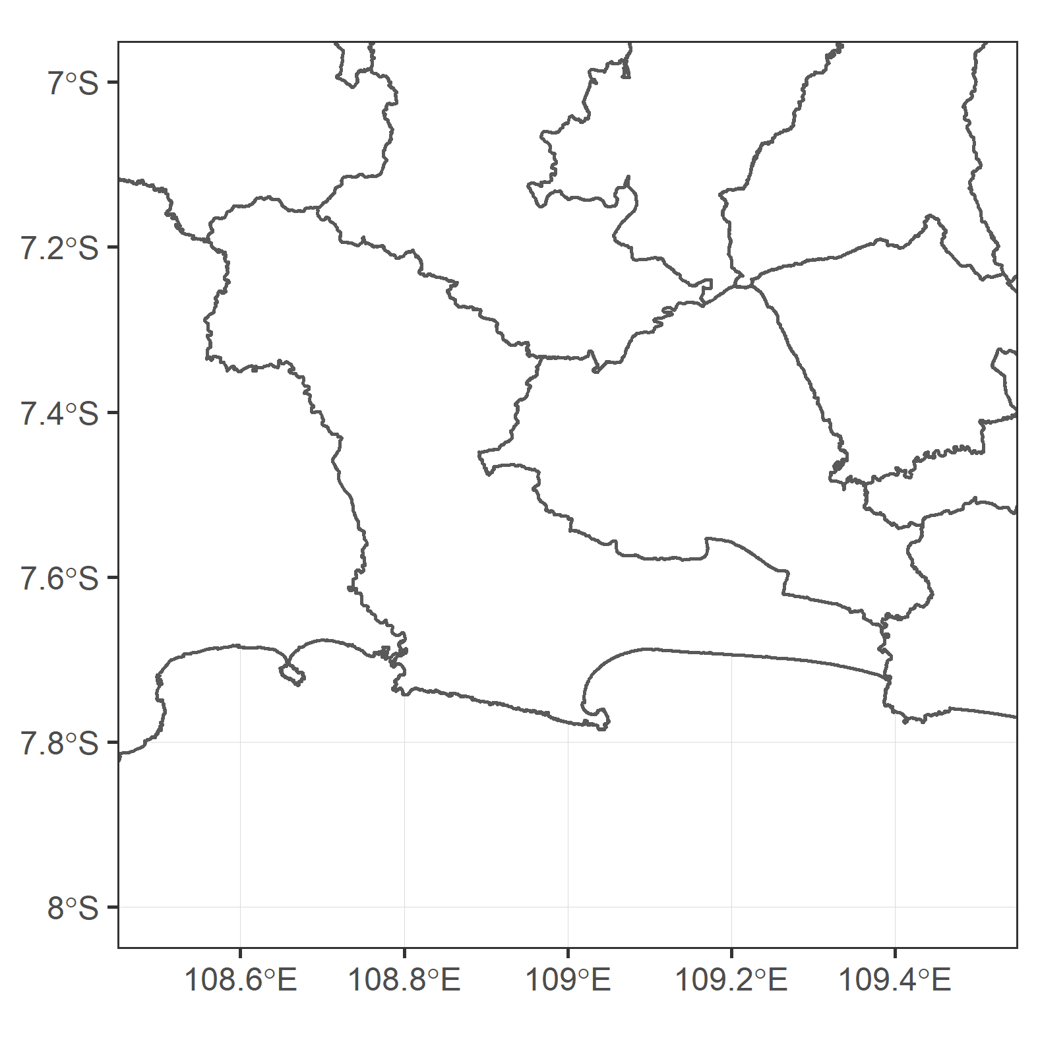
Eligibility for treatment group rests on spatial information

Slide 14
Eligibility for treatment group rests on spatial information

Slide 15
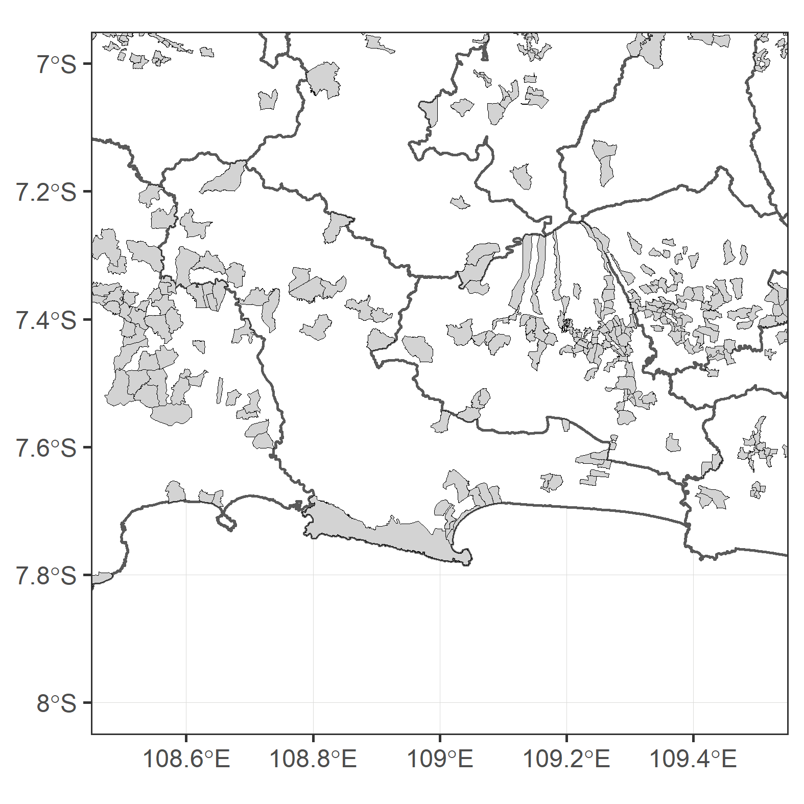
Eligibility for treatment group rests on spatial information
Yearly information on 62,800 manufacturing firms in 9,400 villages (as of 2000)

Slide 16
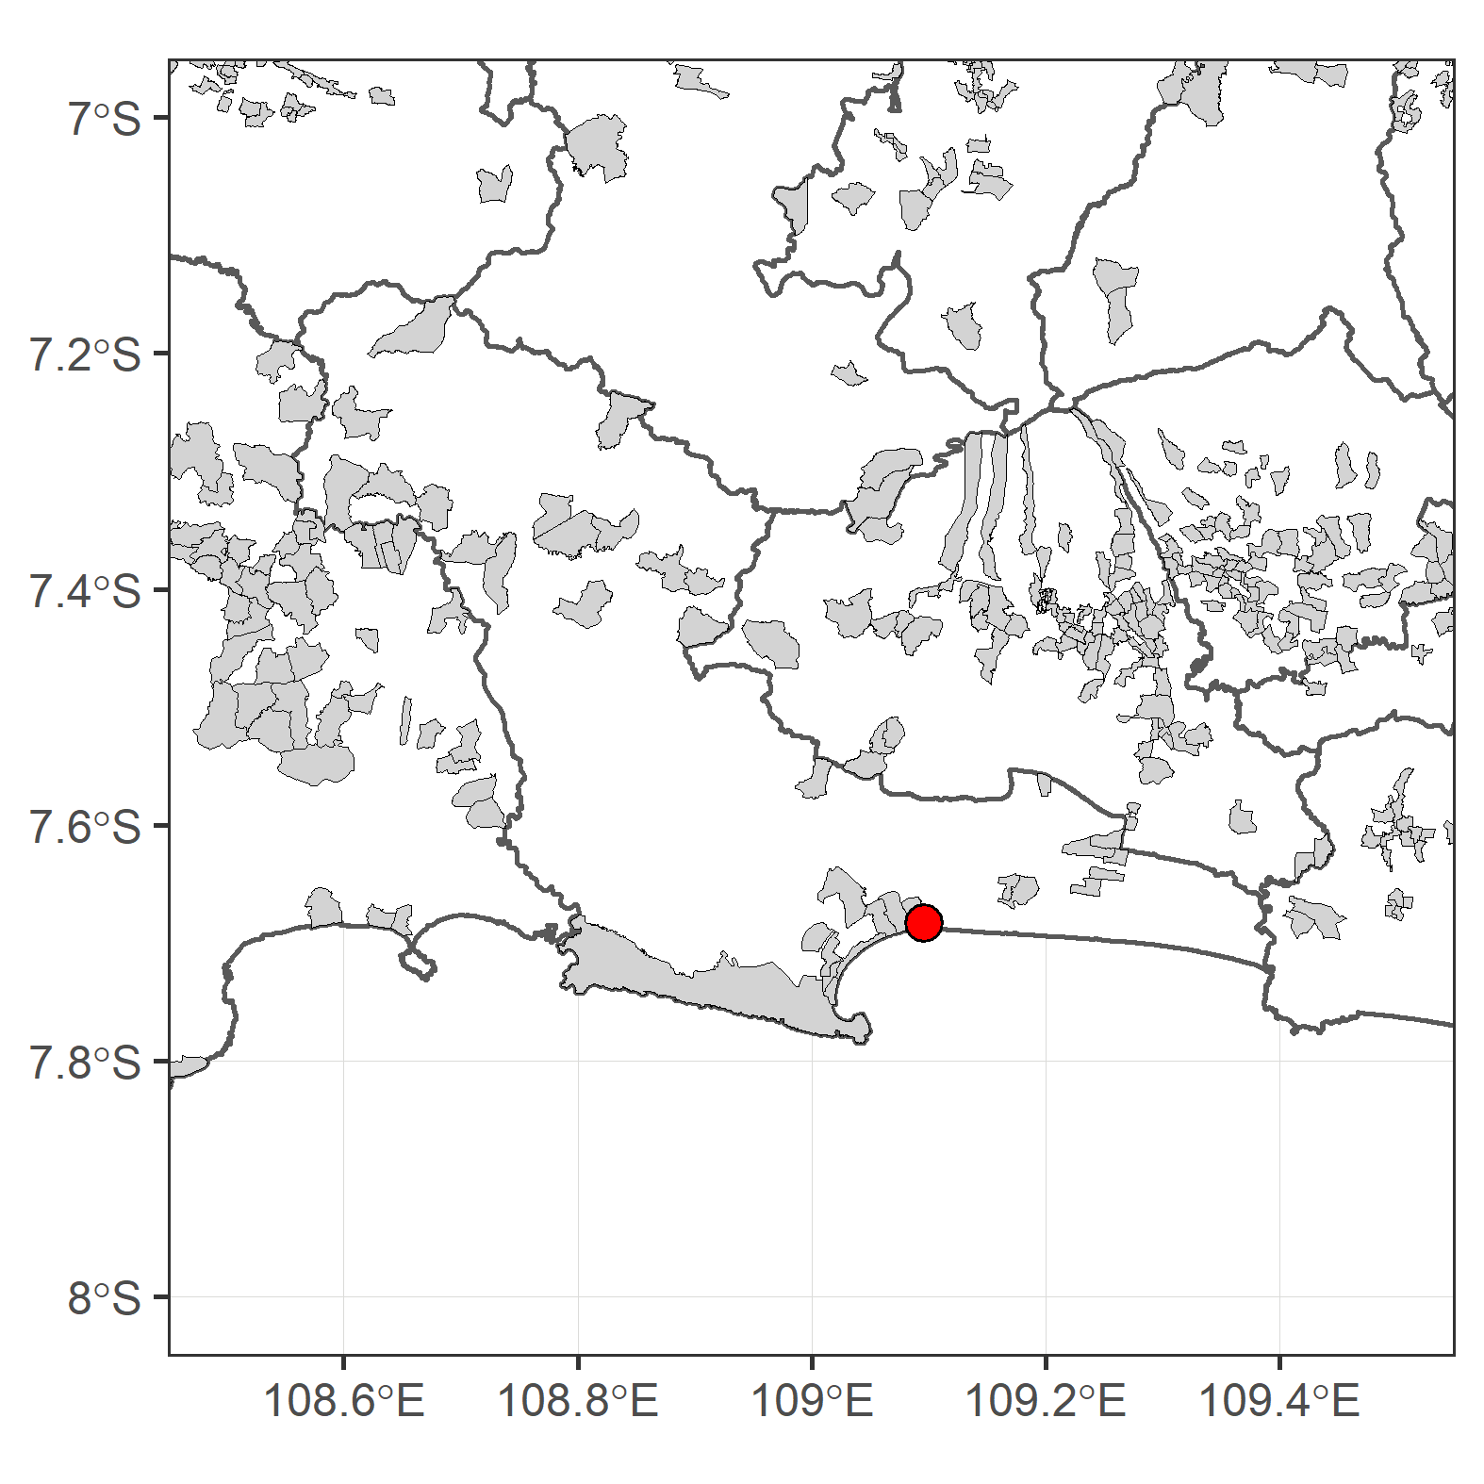
The advent of Cilacap Sumber power station (2,260 MW) in 2006

Slide 17
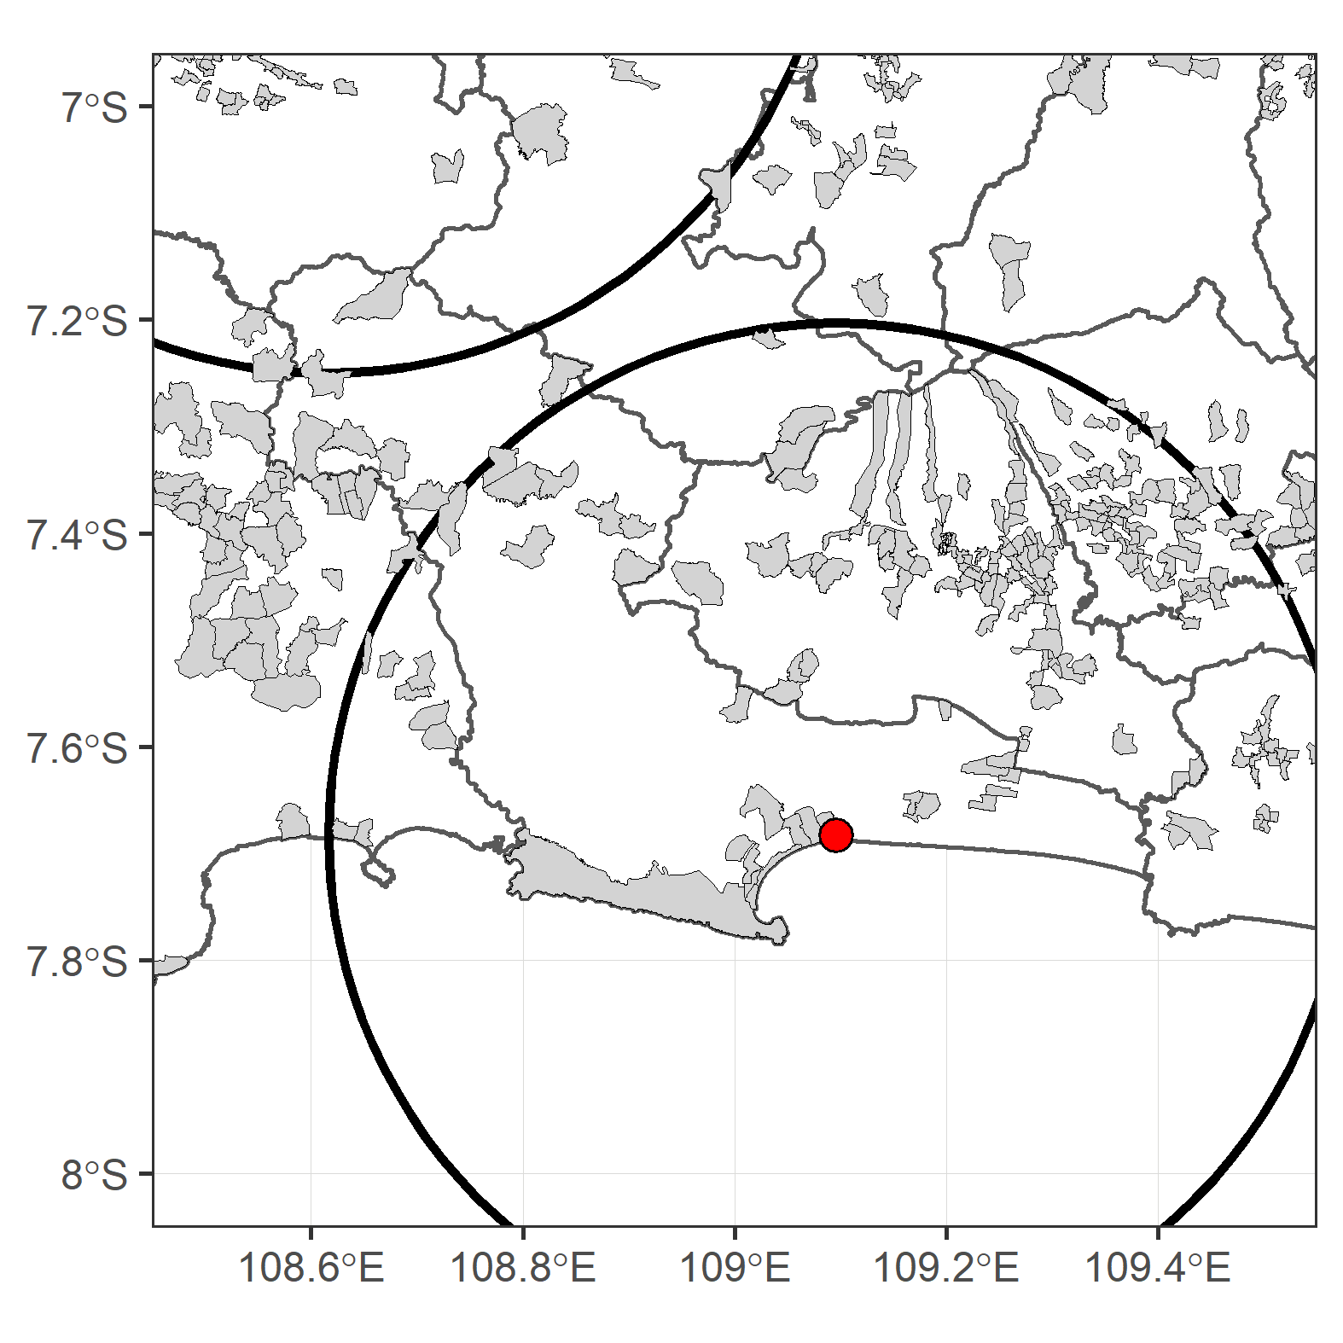
Eligibility for treatment group rests on spatial information
Yearly information on 62,800 manufacturing firms in 9,400 villages (as of 2000)
Granularity of data allows for identification based on spatial distance (e.g. 50 km)

Slide 18
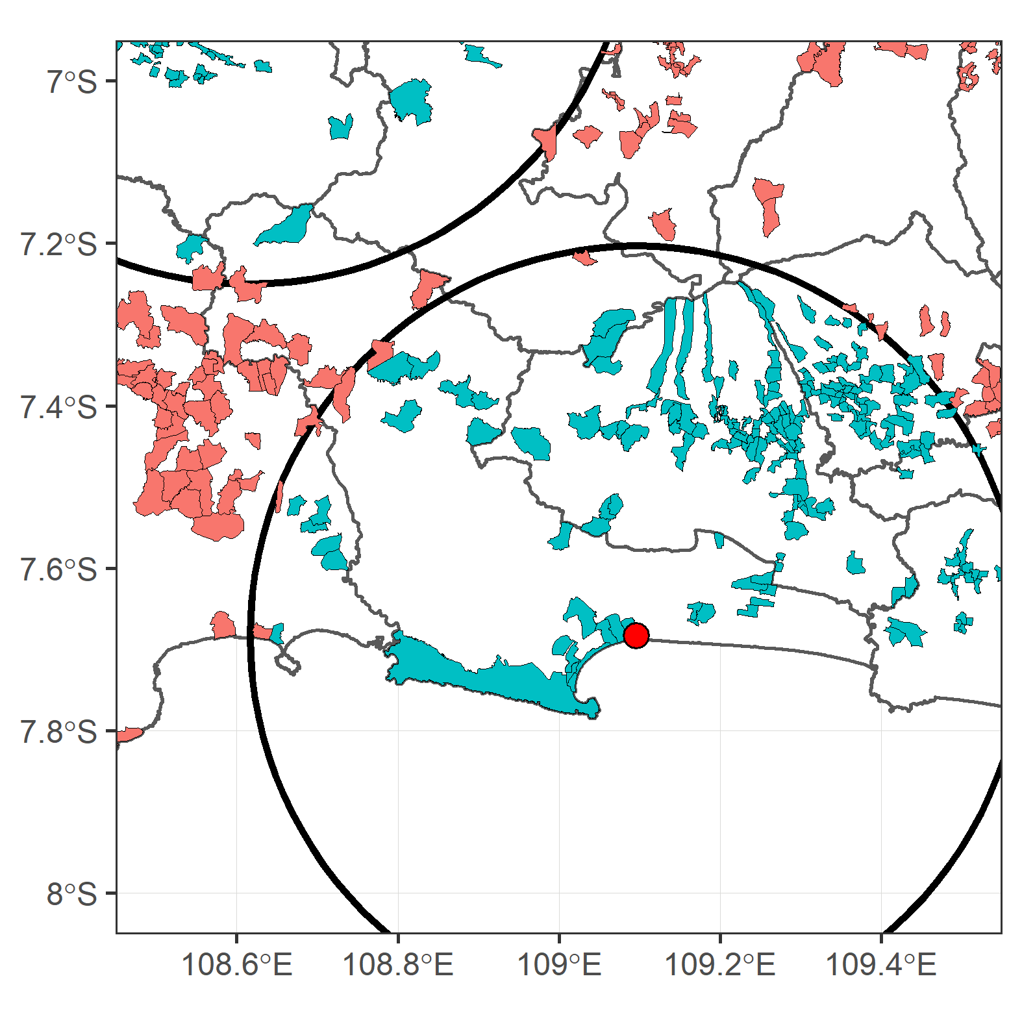
Eligibility for treatment group rests on spatial information
Yearly information on 62,800 manufacturing firms in 9,400 villages (as of 2000)
Granularity of data allows for identification based on spatial distance (e.g. 50 km)
Firms from villages within 50 kilometres are eligible for the treatment group
Firms from other villages are eligible for control group only*
*: in some specifications

Slide 19
Eligibility for treatment group rests on spatial information
Yearly information on 62,800 manufacturing firms in 9,400 villages (as of 2000)
Granularity of data allows for identification based on spatial distance (e.g. 50 km)
Firms from villages within 50 kilometres are eligible for the treatment group
Firms from other villages are eligible for control group only*
*: in some specifications

Slide 20
Firms are unable to predict timing of commissioning

Slide 21
Specification of interest
$y_{i,t}=β_{0}(θ_{d,c}p_{c,t})+η_{c,d}+ρ_{c,t}+λ_{i}+μ_{j,t}+ν_{k,t}+ε_{i,t}$
$β_{0}$ is the average treatment effect (on the treated)
$η_{c,d}$ removes differences between treatment and control group for each cohort
$ρ_{c,t}$ revomes time-variant trends for each cohort
$λ_{i}$, $μ_{j,t}$ and $ν_{k,t}$ are firm-, industry-year- and island-year fixed effects
Results (in essence):
Larger firms benefit, smaller firms do not.
Notes:
Eta
Rho
Lambda, My and Ny

Slide 22
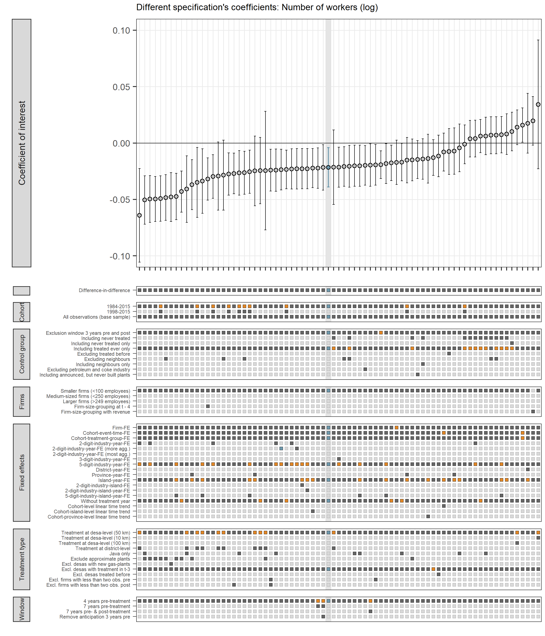
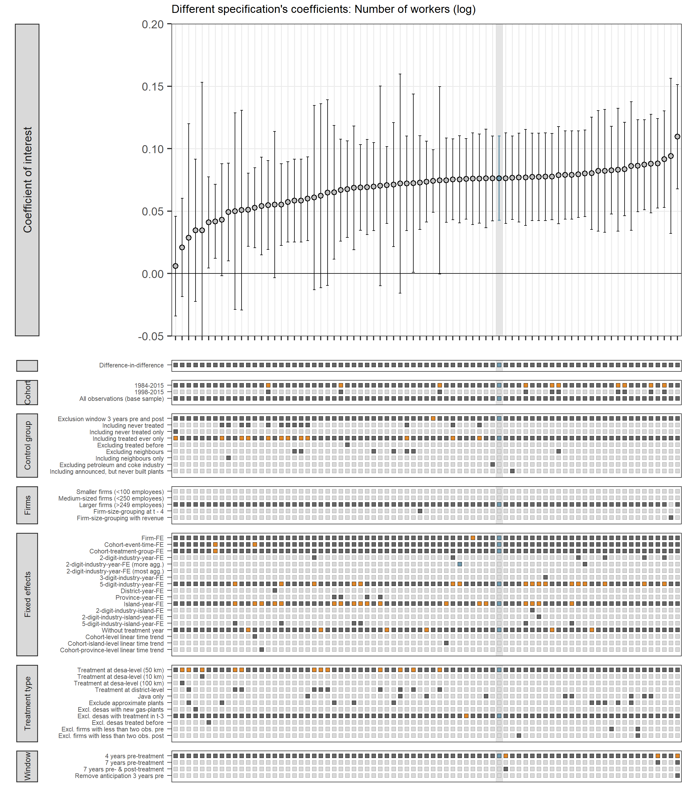
Specification charts help corroborate findings
Small Firms
Large Firms

Slide 23
What you may want to take away
Even if (quasi-)experimental evidence is unavailable, causal graphs can help to identify counterfactual outcomes that are most easily defensible.
Large degree of freedom for researchers:
Use many alternative specifications,
specification charts and
ideally pre-registration to resist temptation of cherry-picking.

Slide 24
Contact
Leonard Missbach
Mercator Research Institute on Global Commons and Climate Change (MCC)
Berlin, Germany
missbach@mcc-berlin.net

