Slide 1
Climate Policies and Green Party Performance in Local Elections
Konrad Bierl, Angelika von dulong, peter Wieland, Klaus eisenack
Humboldt-Universität zu Berlin
Causal Graphs Workshop, April 23rd, 2024
Notes:
Hi everyone.
My name is Peter Wieland and I work as a student assistant at the Resource Economics Group at HU Berlin while doing my Master studies there as well.
With my colleagues Konrad Bierl, Angelika von Dulong and Klaus Eisenack, I am currently working on a project on climate policies and green party performance in local elections in German municipalities.
More specifically, we study the effects of an exogenous variation in green party votes in local elections on renewable energy installation in a period from 2009 to 2016. We try to answer the question if electoral success of green parties leads to more local climate action.
This work is also part of my master thesis, so I’m grateful for the opportunity to present our study here and to receive feedback.

Slide 2
Outline
Motivation
State of the Art
The Case of German Municipalities
Method
4.1 IV Analysis
4.2 Causal Graph
4.3 Data
Preliminary results
Notes:
First of all, a quick look at the outline of my presentation.
First, I will explain our motivation for conducting this study and the state of the art of literature regarding the topic.
Afterwards, I will quickly tell you why we focus on German municipalities specifically.
Then, I will outline out method of choice, which is an Instrumental Variable analysis, including the Causal Graph and the data we are using.
Finally, some preliminary results are presented.

Slide 3
Motivation
Sub-national actors increasingly address climate change
E.g., mitigation & adaptation planning or emission reduction targets
Cities are responsible for 70% of the global greenhouse gas (GHG) emissions
GHG emissions are conventionally considered a global public good
Local governments are not expected to act (free riding incentives)
Notes:
So, why are we conducting this study?
Sub-national actors are increasingly acting on climate change, also on the local level.
For example, through mitigation and adaptation planning or by setting emission reduction targets.
This has immense importance because for example, cities are responsible for over 70% of global greenhouse gas emissions.
GHG emissions are usually considered to be a global public good from a theoretical perspective.
Therefore, we wouldn’t expect local governments to act on reducing GHG emissions, due to free riding incentives.

Slide 4
State of the Art
A set of possible drivers of local governmental climate action
Local governments still implement mitigation policies. Why?
National obligation
Co-benefits
Lobby groups
Local preferences (including political preferences)
Local green party strength
Exposure to climate risks
Notes:
However, local governments still do act on climate change, for example by implementing mitigation policies.
So, we ask ourselves the question, Why?
The literature presents a set of possible drivers for local governmental climate action.
These include national obligation, high exposure to climate risks, co-benefits from policies, such as better air quality, the influence of lobby groups or local preferences including political preferences.
The last point, political preferences, is where our study connects.
We are focusing on the strength of political parties as a determinant, more specifically on the strength of the green party.

Slide 5
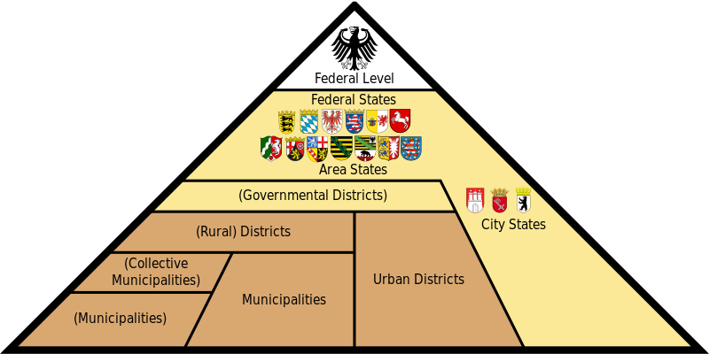
The Case of German Municipalities
Article 28 Grundgesetz
Municipal self-government
Democratically elected governments
Climate policy competencies
Self-government
Governing through enabling
Germany‘s Administrative Division (Source: Wikiepdia Commons)
Bulkeley and Kern (2006)
Notes:
On the right side, you can see Germany’s administrative division.
We are focusing on the smallest entity here, which are municipalities.
They present an especially interesting case, since they are subject of article 28 of the German Grundgesetz.
They must have democratically elected governments, such as local councils, and they are supposed to self-govern in many sectors.
That gives them high climate policy competencies through several channels.
The most important channels are self governing mechanisms, so employing climate mitigation measures on themselves;
;and governing through enabling, so enabling other actors to take climate friendly measures.

Slide 6
Method: Instrumental Variable Analysis
The effect of green political parties (expressed through local council election results) on climate action in municipalities (renewable energy installation)
Endogeneity concerns
Local green votes are expected to be endogenous to voter’s preferences and to other factors such as natural potential and economic growth
Instrument construction
Variations over time in support for the Green Party at the national level
Weekly national opinion polls (Sonntagsfrage)
Notes:
Now we come to the method we are using in our study.
In general, we are studying the effect of green political party strength, expressed by local council election results) on climate action in municipalities.
Climate action is here operationalized as the installation of photovoltaic or wind energy systems.
However, we have some endogeneity concerns. We expect that local green votes are endogenous to voter’s general preferences and to other factors such as natural potential or economic growth.
To overcome this, we employ an instrumental variable approach where we use variations over time in support for the green party on the national level as an instrument.
For this, we use weekly national opinion polls, called the Sonntagsfrage.

Slide 7
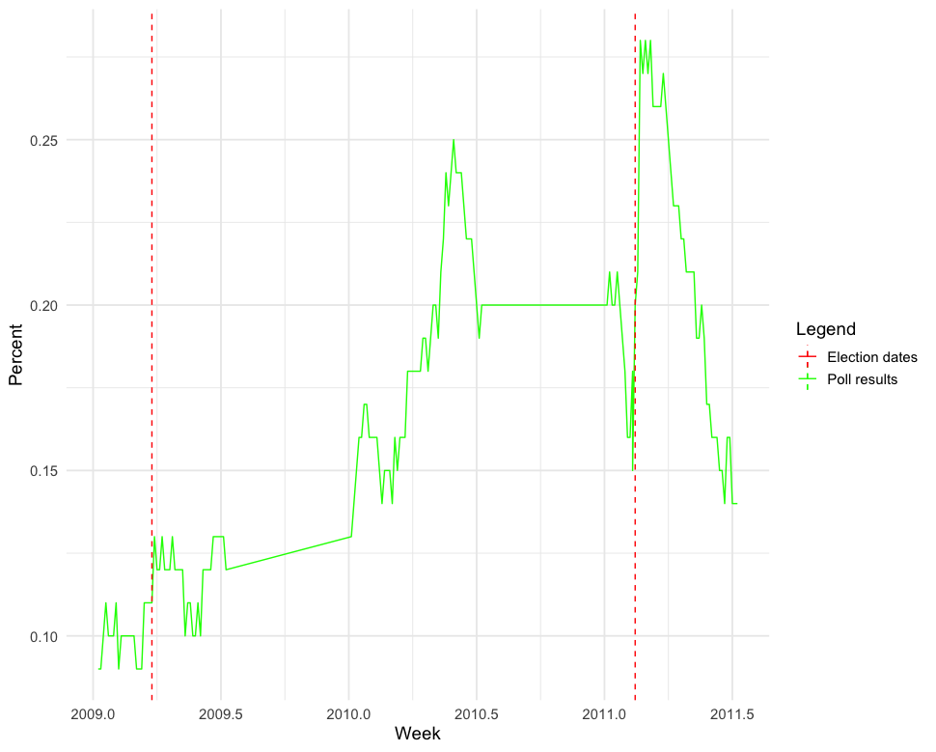
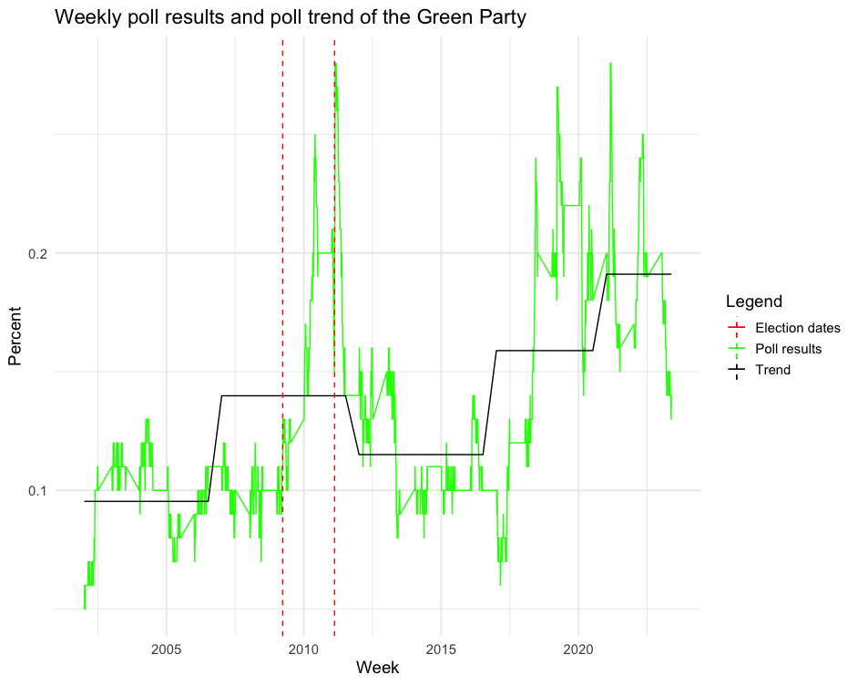
Method: Instrumental Variable Analysis
Instrument
Own presentation
Notes:
Here, you can see these poll results for the green party over time.
We are focusing on one natural spike of green party support between 2009 and 2011 which you can see between the red dotted lines.
Here you can see a closer look at this period. The support for the Green Party wen from 10% in 2009 up to 28% in 2011.
The spike is assumed to be caused by malperformance of the national coalition of Liberals and Conservatives and to a minor part by the Fukushima disaster.
So, we can use these natural fluctuations in green party support on the national level to study exogenous variation in green votes on the local level.

Slide 8
Method: Causal Graph
Notes:
And here is our Causal Graph.
This is the usual graph used for instrumental variable approaches.
On the left, we can see our instruments of election dates and national election polls.
We assume that both only have an effect on our outcome, local climate action, if mediated by the regressor, local green voting.
On the top, you can see possible confounding factors, such as other local preferences.
By using the IV approach, we exclude them and we can study the causal effect of green party strength on local climate action.

Slide 9
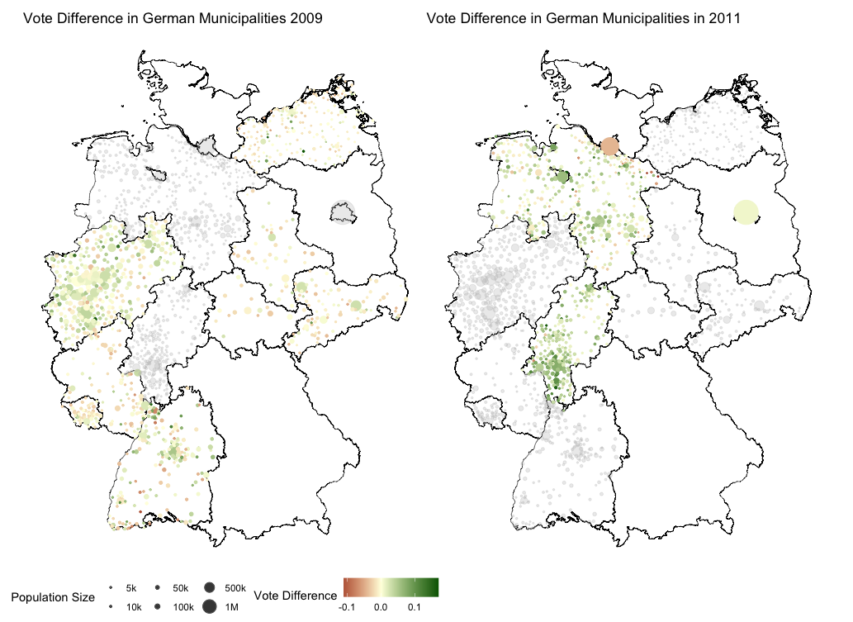
Method: Data
Data types
Weekly election polls (Forsa)
Local council elections (official data)
Renewable energy installations (MaStR)
Sample
2.000 of > 10.000 municipalities
13 of 16 states
Own presentation
Notes:
Now a quick look at our data.
We used three different types of data.
Weekly election polls, which we got from the survey institute Forsa.
Local council election results from official departments of statistics.
And renewable energy data from the Marktstammdatenregister. This is a platform, where every renewable energy system has to be registered.
Our sample no contains about 2.000 of over 10.000 German municipalities from 13 of 16 states.
Many municipalities are missing because no data was available or no local green party existed there.
Here are two maps showing the local election results in 2009 on the left and 2011 on the right compared to the Bundestagswahl in 2009.
We see that indeed, in 2011, where the Green party was more popular on the national level also received more votes on the local level.

Slide 10
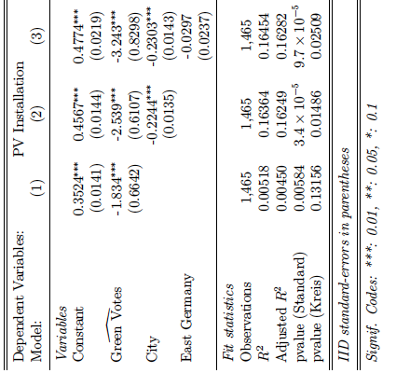
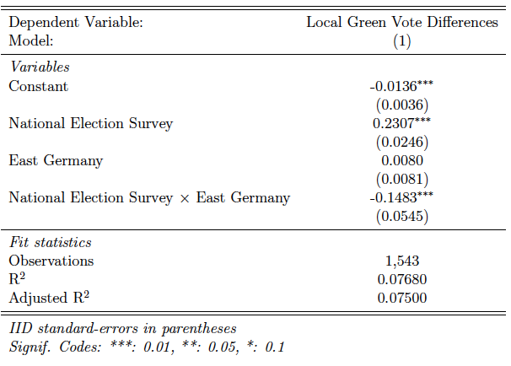
Preliminary Results
First Stage
Second Stage (PV only)
Notes:
And finally, here are the first results of the first and second stage of our analysis.
As you can see, the instrument has indeed an effect on green voting, especially in West Germany.
In East Germany, the effect is weaker. We expect the reason to be different political cultures,
The second stage shows surprisingly that green party strength has a negative effect on PV installation.

Slide 11
Preliminary Results
Possible explanations
Nixon-to-China paradox
Difference in focus between local and national Green Party
Ideas?
Notes:
We thought about some possible explanations for these results.
One idea was the Nixon-to-china paradox translated to our case.
Meaning, that green parties have such high opposition in local councils, that they are unable to implement their environmentally friendly ideas.
Other parties however, have less opposition on such issues and can implement them easier.
Another idea was that the policy focus differs between local green parties and the national green party.
For example, local green parties could have a higher focus on nature reservation instead of building wind energy farms.
Ideas from your side are certainly welcome as well!

Slide 12
Thank you very much for listening!
Questions?
Notes:
Thank you for your attention!
We are now open for questions.

