Slide 1
Identifying Elasticities in Autocorrelated Time Series Using Causal Graphs: An Application to Electricity Demand
Silvana Tiedeman, 1st Applied Causal Graphs Workshop, 22.04.2024
w/ Jorge Sanchez Canales, Felix Schur, Raffaele Sgarlato, Oliver Ruhnau, Lion Hirth, Jonas Peters

Slide 2
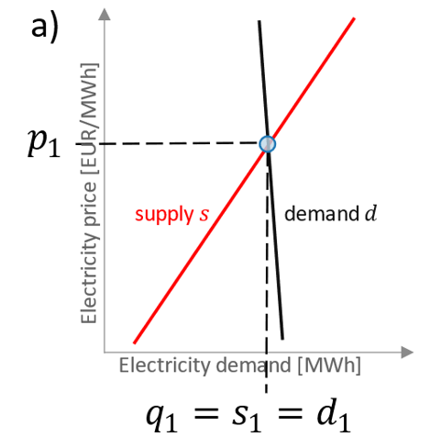
Motivation
How to measure if electricity demand responds to prices, i.e. identify the price elasticity of demand?
P → D ?
Problem of endogeneity (or simultaneity/instantaneous relationships)
Price influences demand P→D
Demand influences prices D → P

Slide 3
Instrumental variables allow overcoming endogeneity
$$I$$
$$X$$
$$U$$
Y

Slide 4
Instrumental variables allow overcoming endogeneity
… but how do we represent equilibrium relationships in a DAG?
Cyclic Graph
Pearl 2009 Book of Why
d
s
x^{d}
x^{s}
Imbens 2020 JER
demand
q
p
x^{d}
x^{s}
supply
Wright 1960 Biometrics

Slide 5
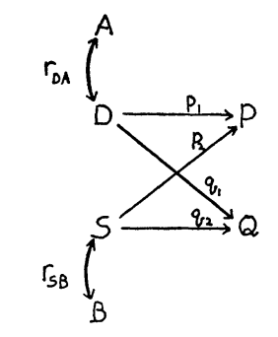
Instrumental variables allow overcoming endogeneity
… but how do we represent equilibrium relationships in a DAG?
Cyclic Graph
Hypothetical variables
Pearl 2009 Book of Why
Imbens 2020 JER
d
s
$$p^{e}$$
x^{d}
x^{s}
$$q^{d}\left(⋅\right)$$
$$q^{s}\left(⋅\right)$$
Imbens 2020 JER
x^{d}
x^{s}
demand
$$q^{e}$$
q
p
x^{d}
x^{s}
Wright 1960 Biometrics
supply
Wright 1960 Biometrics

Slide 6
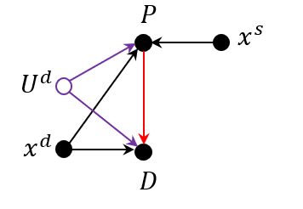
Instrumental variables allow overcoming endogeneity
… but how do we represent equilibrium relationships in a DAG?
Cyclic Graph
Hypothetical variables
Our suggestion
Pearl 2009 Book of Why
Imbens 2020 JER
d
s
$$p^{e}$$
x^{d}
x^{s}
$$q^{d}\left(⋅\right)$$
$$q^{s}\left(⋅\right)$$
Imbens 2020 JER
x^{d}
x^{s}
demand
$$q^{e}$$
q
p
x^{d}
x^{s}
Wright 1960 Biometrics
supply
Wright 1960 Biometrics

Slide 7
$$P_{t}$$
$$D_{t}$$

Slide 8
Demand and supply equations
$$P_{t}$$
$$D_{t}$$

Slide 9
Demand and supply equations
$$P_{t}$$
$$D_{t}$$

Slide 10
Demand and supply equations
$$P_{t}$$
$$U_{t}^{D}$$
$$D_{t}$$

Slide 11
$$W_{t}$$
Demand and supply equations
$$P_{t}$$
$$D_{t}$$

Slide 12
Time series
$$W_{t−2}$$
$$W_{t−1}$$
$$W_{t}$$
Demand and supply equations
$$P_{t−2}$$
$$P_{t−1}$$
$$P_{t}$$
$$D_{t−2}$$
$$D_{t−1}$$
$$D_{t}$$

Slide 13
Time series
$$W_{t−2}$$
$$W_{t−1}$$
$$W_{t}$$
$$P_{t−2}$$
$$P_{t−1}$$
$$P_{t}$$
$$D_{t−2}$$
$$D_{t−1}$$
$$D_{t}$$

Slide 14
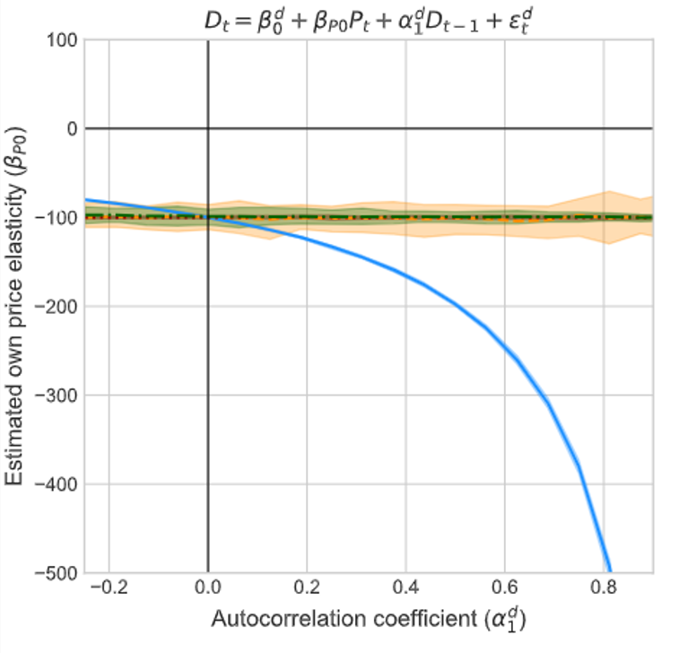
Results of simulation
$$W_{t−2}$$
$$W_{t−1}$$
$$W_{t}$$
$$P_{t−2}$$
$$P_{t−1}$$
$$P_{t}$$
$$D_{t−2}$$
$$D_{t−1}$$
$$D_{t}$$

Slide 15
Results of simulation
$$W_{t−2}$$
$$W_{t−1}$$
$$W_{t}$$
$$P_{t−2}$$
$$P_{t−1}$$
$$P_{t}$$
$$D_{t−2}$$
$$D_{t−1}$$
$$D_{t}$$

Slide 16
Results of simulation
$$W_{t−2}$$
$$W_{t−1}$$
$$W_{t}$$
$$P_{t−2}$$
$$P_{t−1}$$
$$P_{t}$$
$$D_{t−2}$$
$$D_{t−1}$$
$$D_{t}$$

Slide 17
Results of simulation
$$W_{t−2}$$
$$W_{t−1}$$
$$W_{t}$$
$$P_{t−2}$$
$$P_{t−1}$$
$$P_{t}$$
$$D_{t−2}$$
$$D_{t−1}$$
$$D_{t}$$

Slide 18
Results of simulation
$$W_{t−2}$$
$$W_{t−1}$$
$$W_{t}$$
$$P_{t−2}$$
$$P_{t−1}$$
$$P_{t}$$
$$D_{t−2}$$
$$D_{t−1}$$
$$D_{t}$$
Nuisance Effect → nuisance IV (Thams et al. 2022)

Slide 19
An approach for model validation
Step 1: Formalize assumptions in a structural causal model

Slide 20
An approach for model validation
Step 1: Formalize assumptions in a structural causal model
A) Inertial demand
B) Partially responsive demand
C) Demand shifting
$$W_{t−2}$$
$$W_{t−1}$$
$$W_{t}$$
$$W_{t−2}$$
$$W_{t−1}$$
$$W_{t}$$
$$W_{t−2}$$
$$W_{t−1}$$
$$W_{t}$$
$$P_{t−2}$$
$$P_{t−1}$$
$$P_{t}$$
$$P_{t−2}$$
$$P_{t−1}$$
$$P_{t}$$
$$P_{t−2}$$
$$P_{t−1}$$
$$P_{t}$$
$$D_{t−2}$$
$$D_{t−1}$$
$$D_{t}$$
$$D_{t−2}$$
$$D_{t−1}$$
$$D_{t}$$
$$D_{t−2}$$
$$D_{t−1}$$
$$D_{t}$$

Slide 21
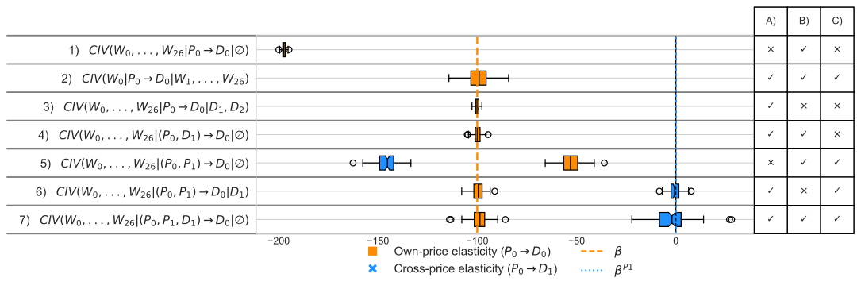
An approach for model validation
Step 1: Formalize assumptions in a structural causal model
Step 2: Derive valid estimators from related DAG

Slide 22
An approach for model validation
Step 1: Formalize assumptions in a structural causal model
Step 2: Derive valid estimators from related DAG
Step 3: Check alignment of estimators
Step 4: Reject model (and repeat)

Slide 23
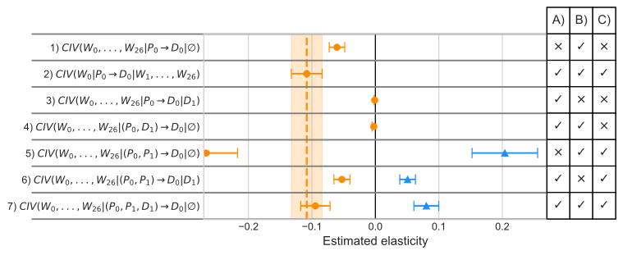
Application: German aggregated electricity demand (2015-2019)

Slide 24
Conclusion
We can use the insights from causal graphs to overcome the autocorrelation and block/remove biasing paths, yielding a valid estimate for the effect of prices on hourly electricity demand.
Using d-separation/CIV-criteria, we can derive several valid estimators for a given structural model. If they estimators yield different results, the model is wrong, and we can reject the assumptions encoded in the structural model.
German hourly electricity demand is more responsive to prices (-230 MW/EUR) than previously thought, and likely depends structurally on its past realizations.

Slide 26
DAG @ equilibrium
“In fact, it is not immediately obvious to me how one would capture supply and demand models in a DAG. [... A graph] capturing the simultaneity by having arrows go from prices to quantities and back [...] does not [...] really capture what is going on. It is not the case that there is an effect of prices on quantities [in equilibrium] that corresponds to the demand function and an effect from quantities to prices that captures supply. Rather, [...] the demand and supply functions are the primitives. Together they determine both equilibrium prices and quantities. The identification comes from the presence of observed demand and supply shifters. [...] It would also be helpful if the DAG researchers engaged more fully with such models where equilibrium plays a central role." (Imbens 2020, p. 1162-1163)
Imbens (2020)
Our model
z^{s}
c)
a)
b)
$$P$$
demand
$$p^{e}$$
q
p
$$x^{s}$$
$$q^{d}\left(⋅\right)$$
$$q^{s}\left(⋅\right)$$
x^{d}
x^{s}
x^{d}
x^{s}
$$U^{d}$$
supply
$$x^{d}$$
$$q^{e}$$
$$D$$
d
s
x^{d}
x^{s}

Slide 27
Including control sets
W_{t-2}
W_{t-1}
W_{t}
T _{t-1}
T _{t-1}
T _{t}
S _{t}
S _{t}
S _{t}
P _{t-2}
P _{t-1}
P _{t}
H _{t-1}
H _{t-1}
H _{t}
DI_{t-2}
DI_{t-1}
DI_{t}
D_{t-2}
D_{t-1}
D_{t}
DH_{t-2}
DH_{t-1}
DH_{t}

Slide 28
Method 2 Steps: Example for cross-price elasticity
Without cross-price elasticity $q_{d}=f({p_{t}, )≠f(p}_{\left\{t−1\right\}})$
Derive valid estimators
With cross-price elasticity $q_{d}=f({p_{t}, p}_{\left\{t−1\right\}})$
$$W_{t−2}$$
$$W_{t−1}$$
$$W_{t}$$
$$w_{t−2}$$
$$w_{t−1}$$
$$w_{t}$$
$$P_{t−2}$$
$$P_{t−1}$$
$$P_{t}$$
$$p_{t−2}^{e}$$
$$p_{t−1}^{e}$$
$$p_{t}^{e}$$
$$Q_{t−2}$$
$$Q_{t−1}$$
$$Q_{t}$$
$$q_{t−2}^{e}$$
$$q_{t−1}^{e}$$
$$q_{t}^{e}$$

Slide 29
Method 2 Steps: Example for cross-price elasticity
Without cross-price elasticity $q_{d}=f({p_{t}, )≠f(p}_{\left\{t−1\right\}})$
Derive valid estimators
With cross-price elasticity $q_{d}=f({p_{t}, p}_{\left\{t−1\right\}})$
$$W_{t−2}$$
$$W_{t−1}$$
$$W_{t}$$
$$w_{t−2}$$
$$w_{t−1}$$
$$w_{t}$$
$$P_{t−2}$$
$$P_{t−1}$$
$$P_{t}$$
$$p_{t−2}^{e}$$
$$p_{t−1}^{e}$$
$$p_{t}^{e}$$
$$Q_{t−2}$$
$$Q_{t−1}$$
$$Q_{t}$$
$$q_{t−2}^{e}$$
$$q_{t−1}^{e}$$
$$q_{t}^{e}$$

Slide 30
Method 2 Steps: Example for cross-price elasticity
Without cross-price elasticity $q_{d}=f({p_{t}, )≠f(p}_{\left\{t−1\right\}})$
Derive valid estimators
With cross-price elasticity $q_{d}=f({p_{t}, p}_{\left\{t−1\right\}})$
$$W_{t−2}$$
$$W_{t−1}$$
$$W_{t}$$
$$w_{t−2}$$
$$w_{t−1}$$
$$w_{t}$$
$$P_{t−2}$$
$$P_{t−1}$$
$$P_{t}$$
$$p_{t−2}^{e}$$
$$p_{t−1}^{e}$$
$$p_{t}^{e}$$
$$Q_{t−2}$$
$$Q_{t−1}$$
$$Q_{t}$$
$$q_{t−2}^{e}$$
$$q_{t−1}^{e}$$
$$q_{t}^{e}$$

Slide 31
Notation
Notation 1
Notation 2

Slide 32
Method 2 Steps: Example for cross-price elasticity
Derive valid estimators
With cross-price elasticity $q_{d}=f({p_{t}, p}_{\left\{t−1\right\}})$
Without cross-price elasticity $q_{d}=f({p_{t}, )≠f(p}_{\left\{t−1\right\}})$
$$w_{t−2}$$
$$w_{t−1}$$
$$w_{t}$$
$$w_{t−2}$$
$$w_{t−1}$$
$$w_{t}$$
$$p_{t−2}^{e}$$
$$p_{t−1}^{e}$$
$$p_{t}^{e}$$
$$p_{t−2}^{e}$$
$$p_{t−1}^{e}$$
$$p_{t}^{e}$$
$$q_{t−2}^{e}$$
$$q_{t−1}^{e}$$
$$q_{t}^{e}$$
$$q_{t−2}^{e}$$
$$q_{t−1}^{e}$$
$$q_{t}^{e}$$

Slide 33
Method 2 Steps: Example for cross-price elasticity
Derive valid estimators
With cross-price elasticity $q_{d}=f({p_{t}, p}_{\left\{t−1\right\}})$
Without cross-price elasticity $q_{d}=f({p_{t}, )≠f(p}_{\left\{t−1\right\}})$
$$w_{t−2}$$
$$w_{t−1}$$
$$w_{t}$$
$$w_{t−2}$$
$$w_{t−1}$$
$$w_{t}$$
$$p_{t−2}^{e}$$
$$p_{t−1}^{e}$$
$$p_{t}^{e}$$
$$p_{t−2}^{e}$$
$$p_{t−1}^{e}$$
$$p_{t}^{e}$$
$$q_{t−2}^{e}$$
$$q_{t−1}^{e}$$
$$q_{t}^{e}$$
$$q_{t−2}^{e}$$
$$q_{t−1}^{e}$$
$$q_{t}^{e}$$

Slide 34
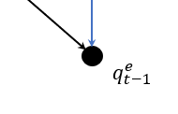
Method 2 Steps: Example for cross-price elasticity
Derive valid estimators
With cross-price elasticity $q_{d}=f({p_{t}, p}_{t−1})$
Without cross-price elasticity $q_{d}=f({p_{t}, )≠f(p}_{t−1})$
$$w_{t−2}$$
$$w_{t−1}$$
$$w_{t}$$
$$w_{t−2}$$
$$w_{t−1}$$
$$w_{t}$$
$$p_{t−2}^{e}$$
$$p_{t−1}^{e}$$
$$p_{t}^{e}$$
$$p_{t−2}^{e}$$
$$p_{t−1}^{e}$$
$$p_{t}^{e}$$
$$q_{t−2}^{e}$$
$$q_{t−1}^{e}$$
$$q_{t}^{e}$$
$$q_{t−2}^{e}$$
$$q_{t−1}^{e}$$
$$q_{t}^{e}$$

Slide 35
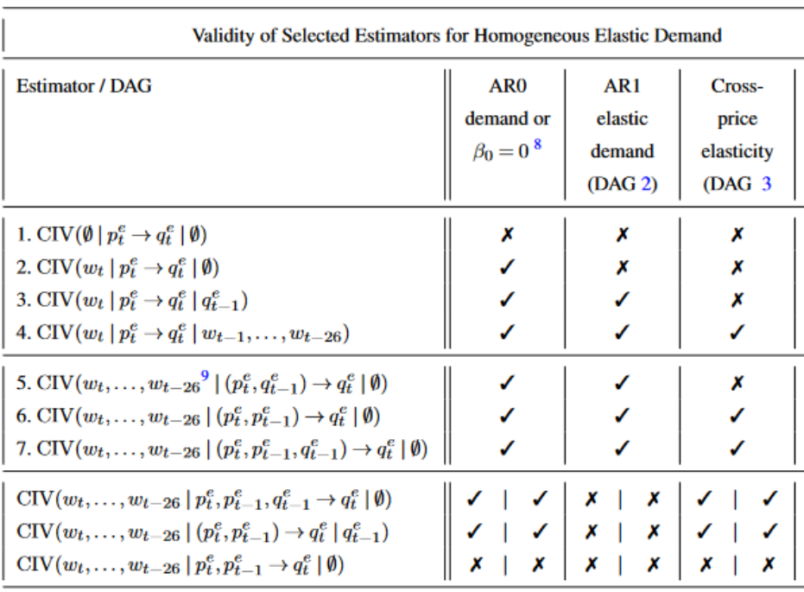
Method 2 Steps: Example for cross-price elasticity
Derive valid estimators

Slide 36
CIV-demand valid across specifications

Slide 37
a) Full graph
b) Marginalized graph
$$U^{D}$$
$$W$$
$$P$$
$$D$$
$$W$$
$$P$$
$$D$$

Slide 38
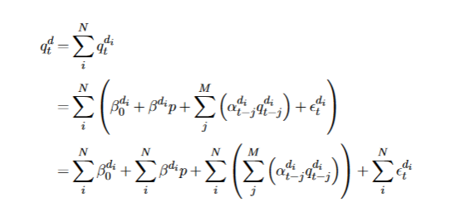
Model variations (all AR + price elastic)
Simple
Complex
Homogenous
Heterogenous, unobserved
Cross-price elasticities
demand
function
$$w_{t−2}$$
$$w_{t−1}$$
$$w_{t}$$
$$w_{t−2}$$
$$w_{t−1}$$
$$w_{t}$$
$$w_{t−2}$$
$$w_{t−1}$$
$$w_{t}$$
DAG
$$p_{t−2}^{e}$$
$$p_{t−1}^{e}$$
$$p_{t}^{e}$$
$$p_{t−2}^{e}$$
$$p_{t−1}^{e}$$
$$p_{t}^{e}$$
$$p_{t−2}^{e}$$
$$p_{t−1}^{e}$$
$$p_{t}^{e}$$
$$q_{t−2}^{d_{1}}$$
$$q_{t−1}^{d_{1}}$$
$$q_{t}^{d_{1}}$$
$$q_{t−2}^{e}$$
$$q_{t−1}^{e}$$
$$q_{t}^{e}$$
$$q_{t−2}^{e}$$
$$q_{t−1}^{e}$$
$$q_{t}^{e}$$
$$q_{t−2}^{e}$$
$$q_{t−1}^{e}$$
$$q_{t}^{e}$$
$$q_{t−2}^{d_{1}}$$
$$q_{t−1}^{d_{1}}$$
$$q_{t}^{d_{1}}$$

Slide 39
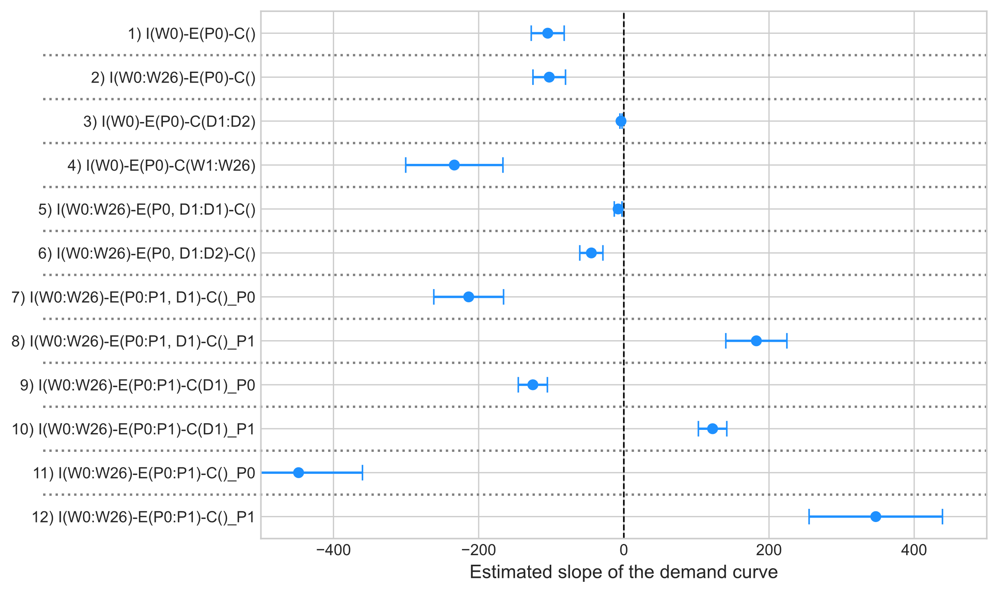
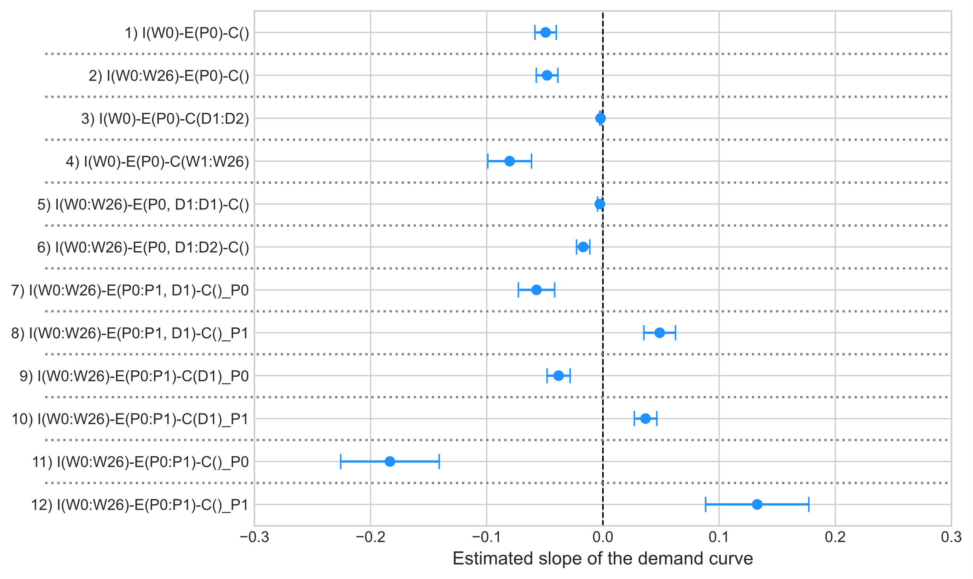
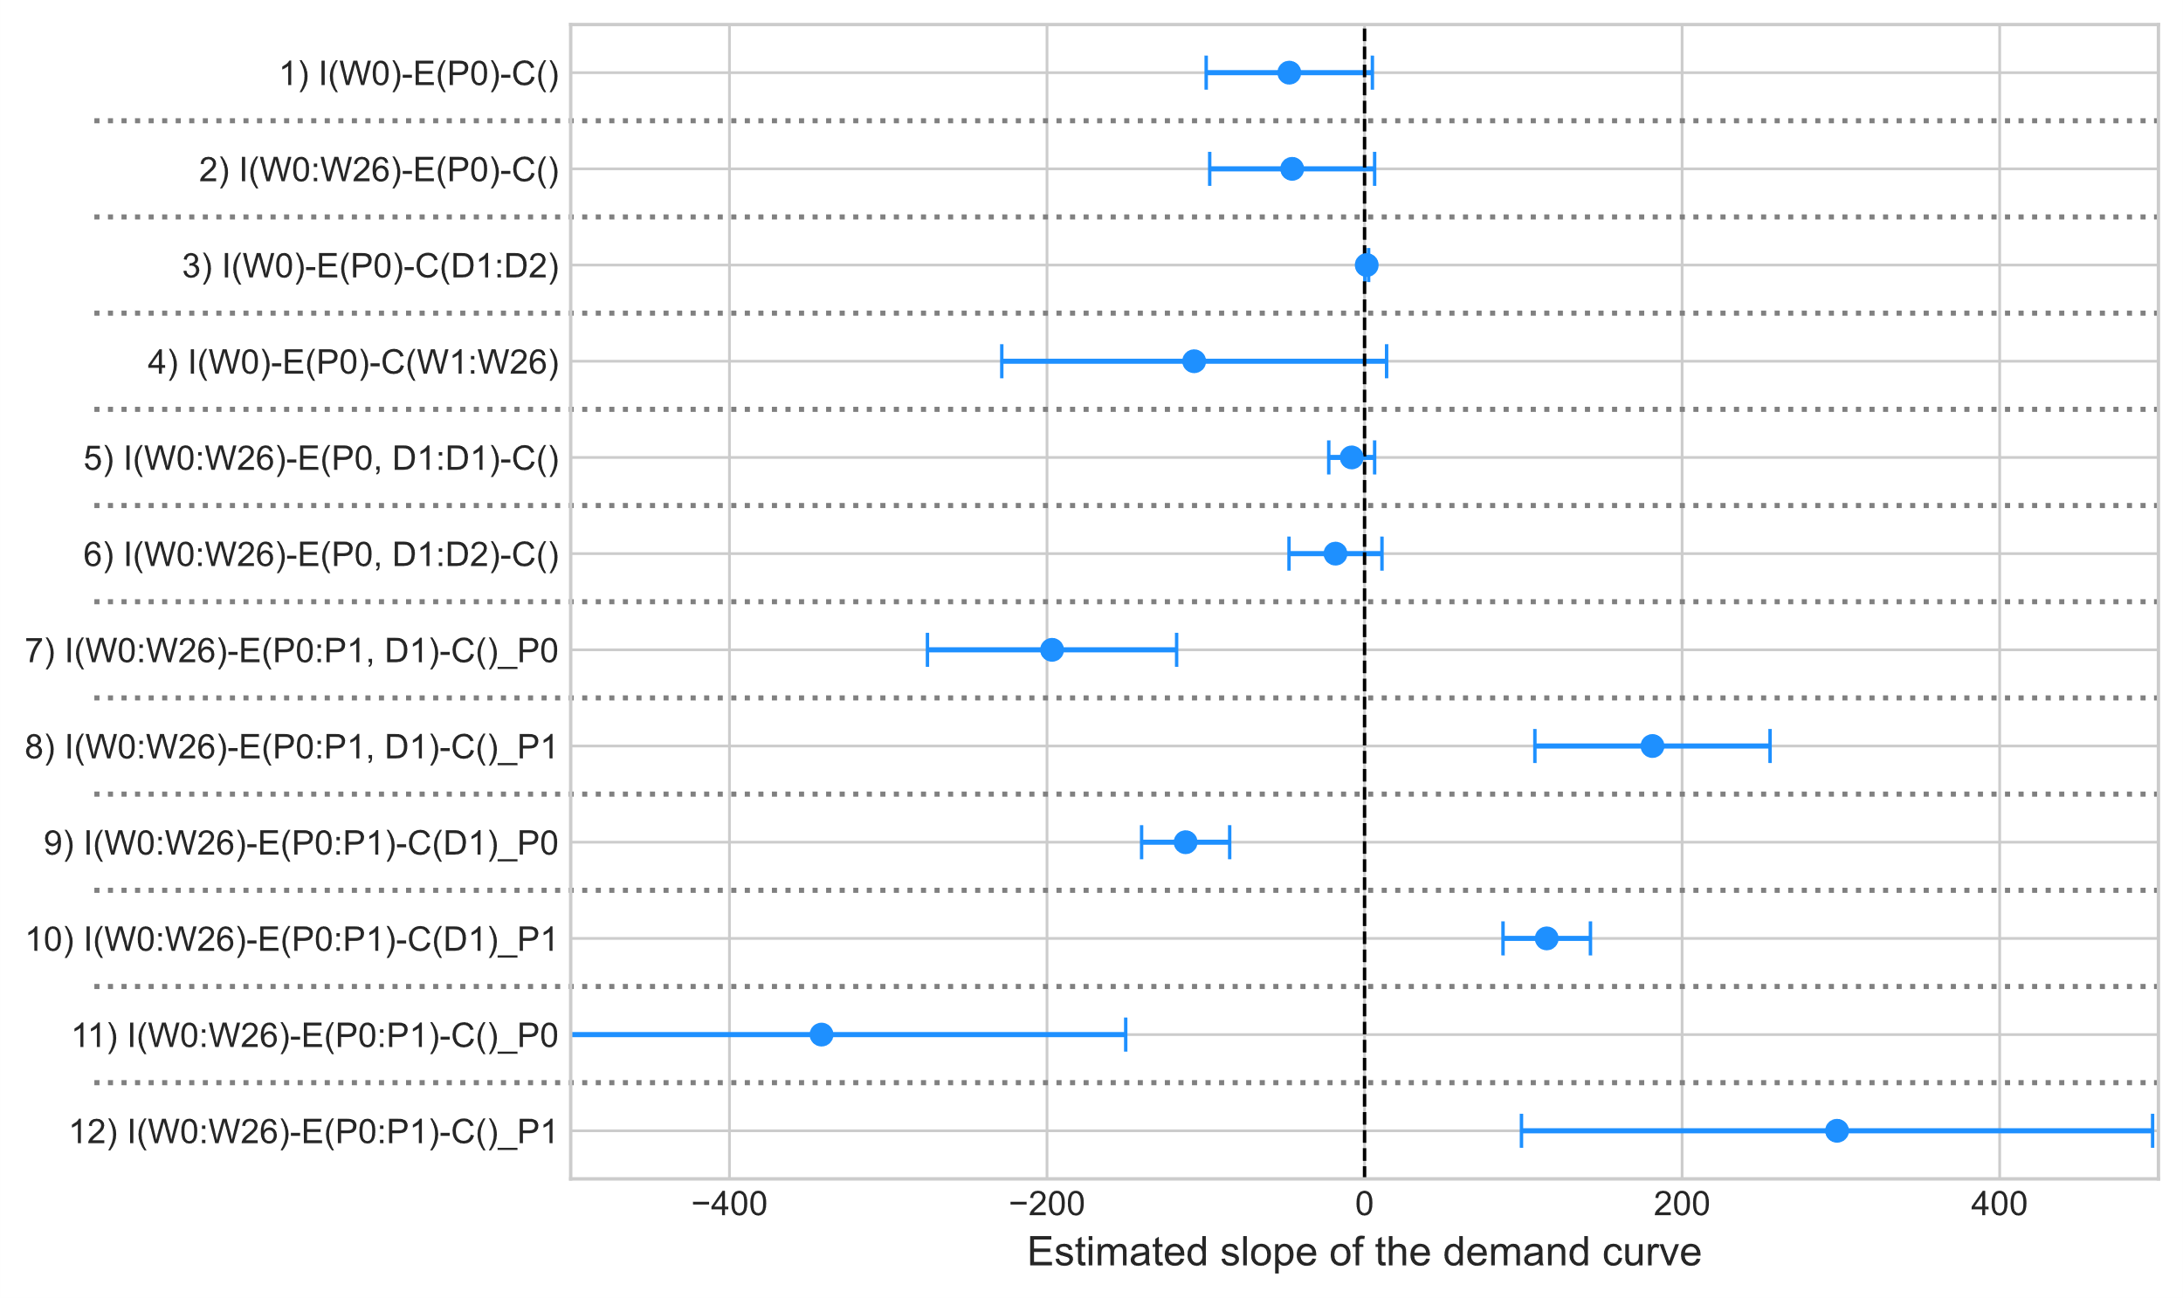
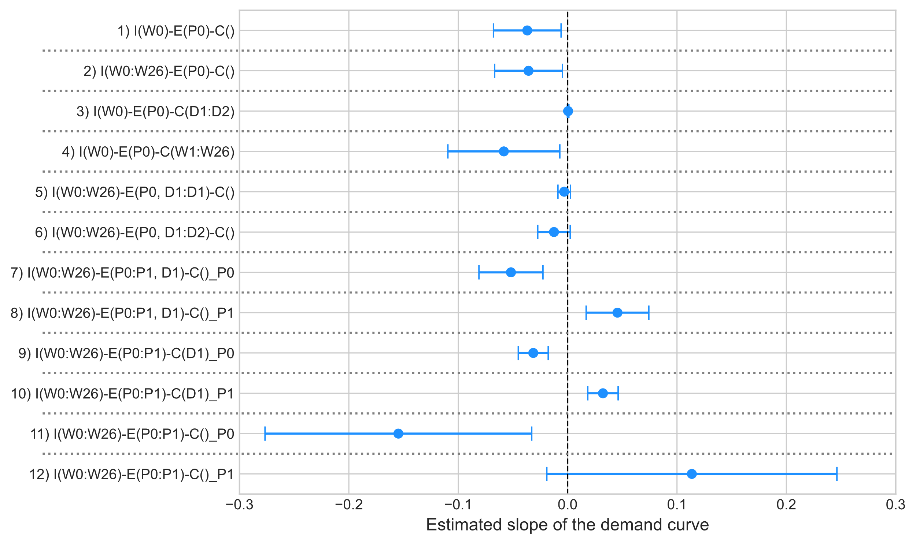
Should we include temperature and solar generation in the conditioning sets?
linear
log-log
PV = proxy for irradiation
weather
conditions
$$wind$$
temper-ature
price
cloudiness
PV generation
full controls
$$demand$$
irradiation
demand for lighting
Minimal controls only includes:
Hour of the day dummies
Month of the year dummies
HDD and CDD
Solar PV Generation
Full control:
+ prices: EU ETS, coal, gas
+ sunlight dummy
+ day-of-the-week
+ holiday dummies
minimal controls

Slide 40
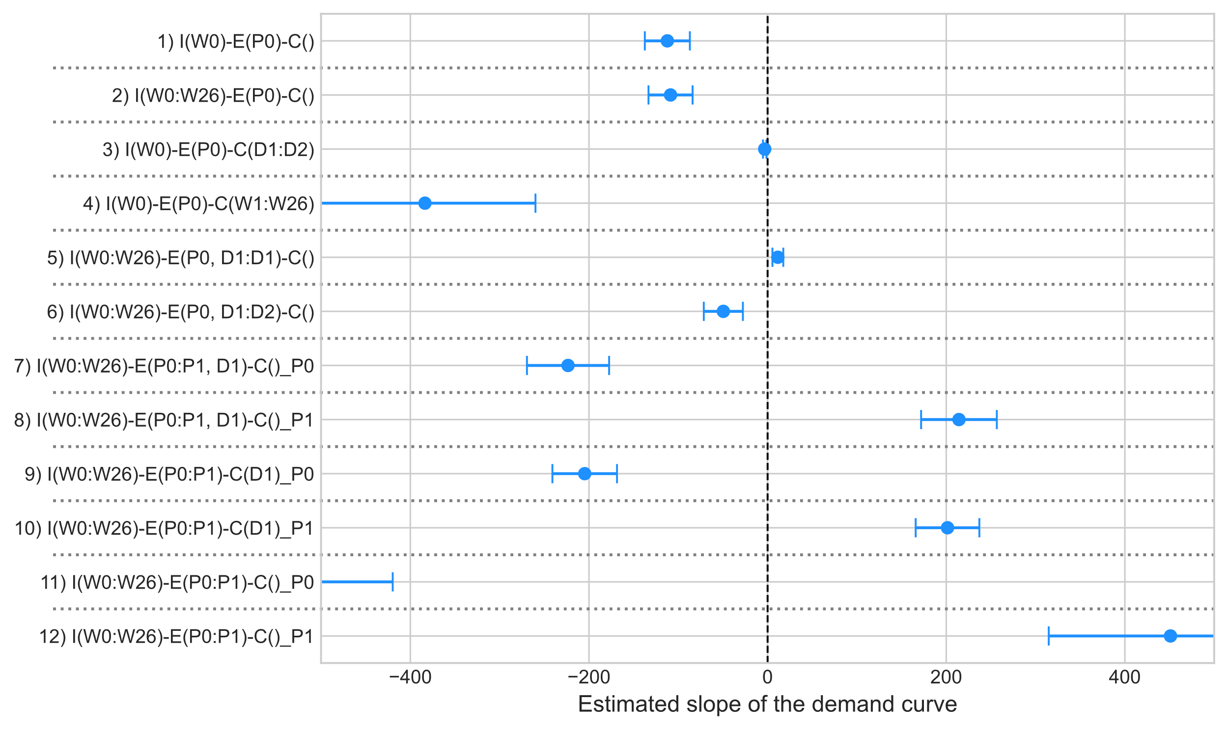
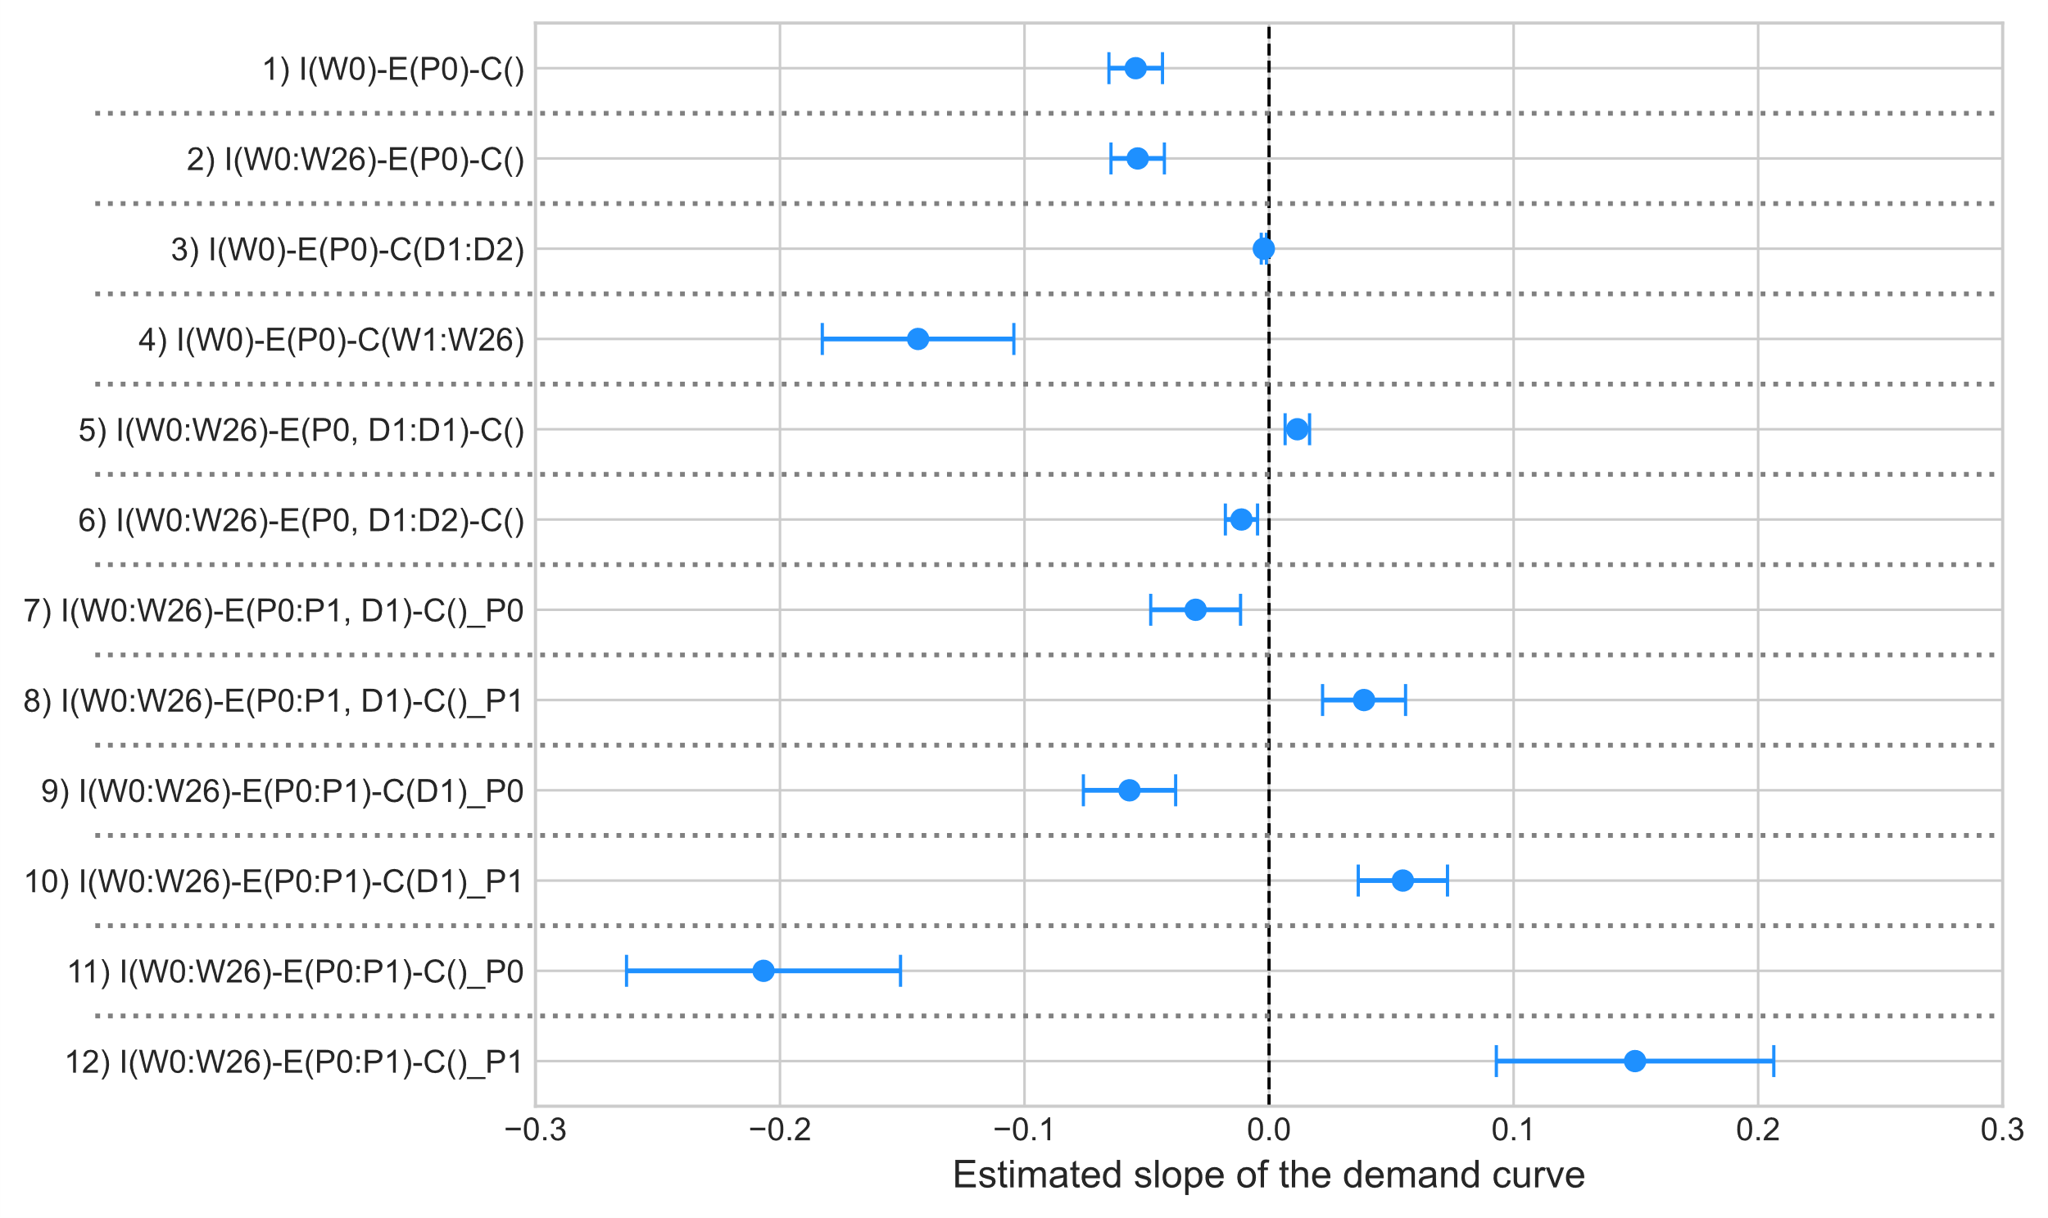
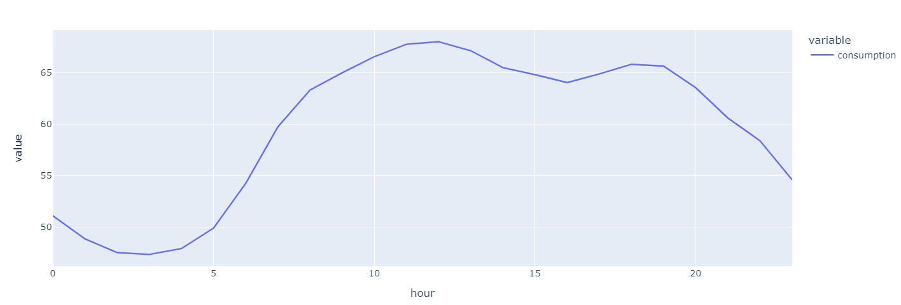
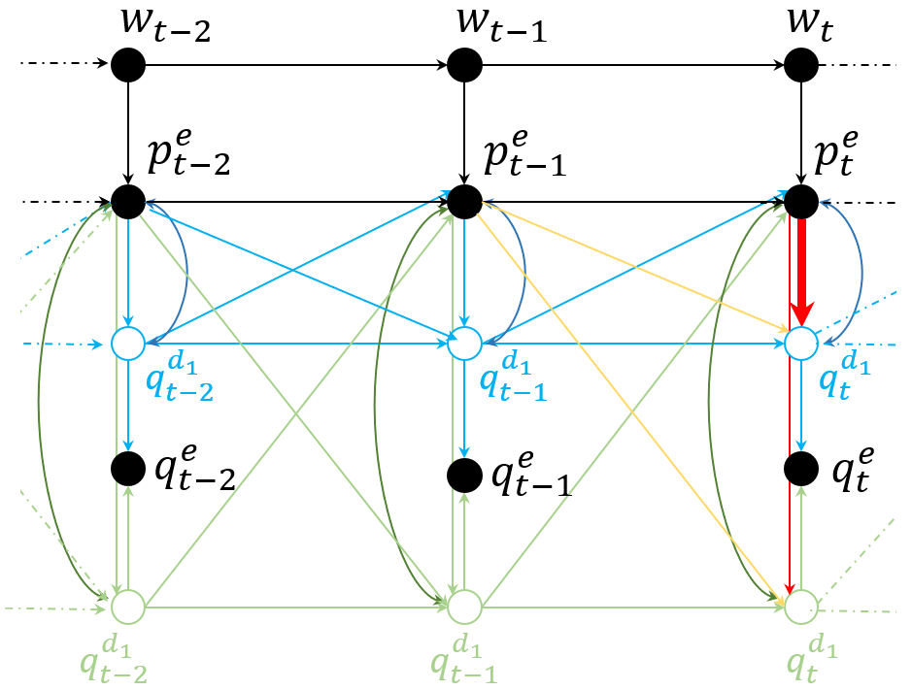
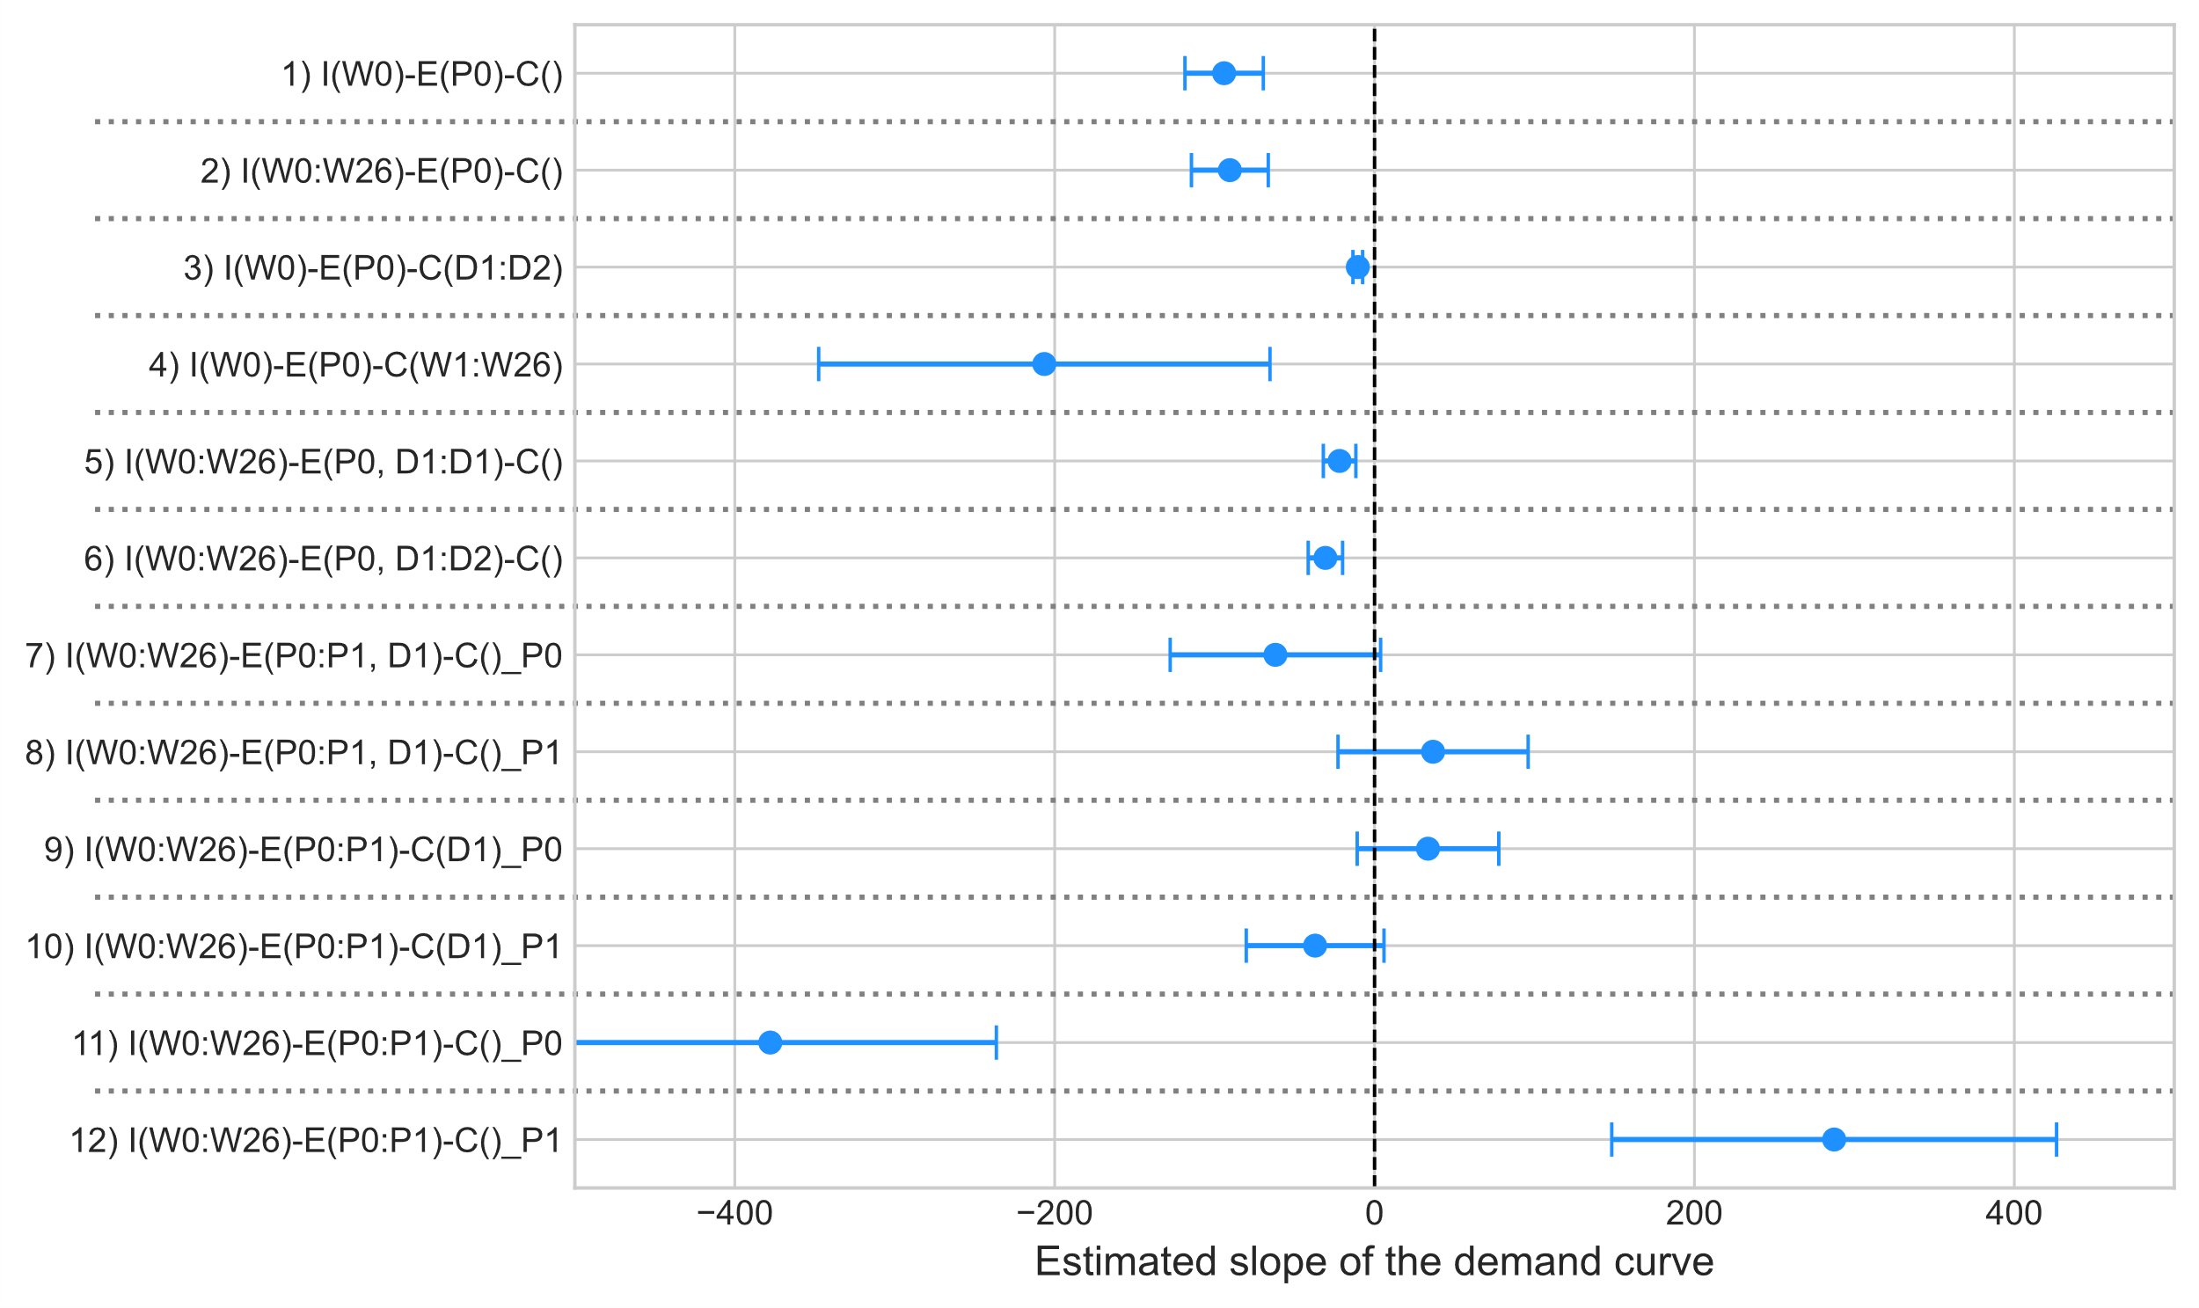
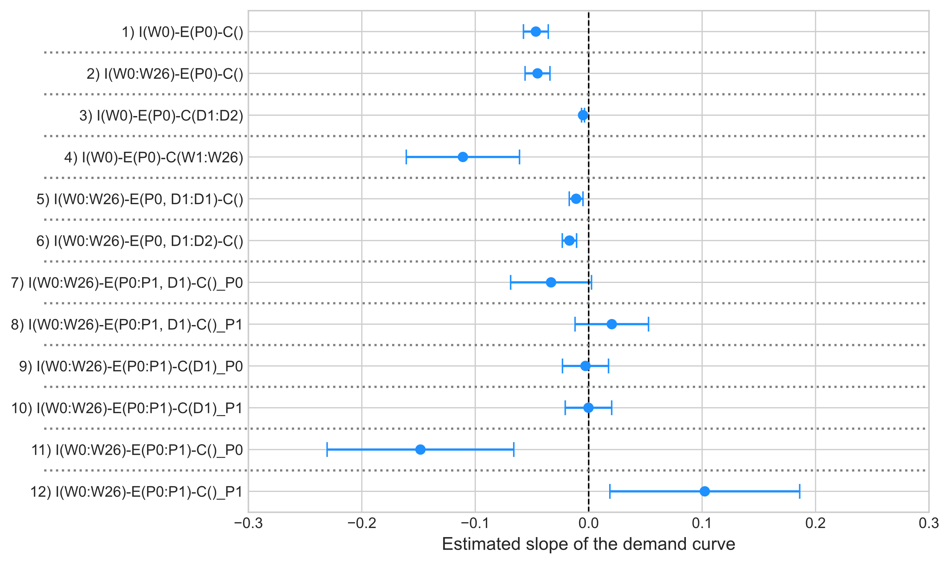
Sensitivity: Splitting between day and night
linear
log-log
day
day (8am-8pm)
night (8 pm-8am)

Slide 41
Home | Hetero | Cross | Heter + Cross
X | X | X | X
X | X | X | X
 | X | X | X
 | X | X | X
 | X | X | X
 | X |  | ? (what if d2 is price inelastic)?
-
 | X |  | X
-
? | ? | ? | ?
-

Slide 42
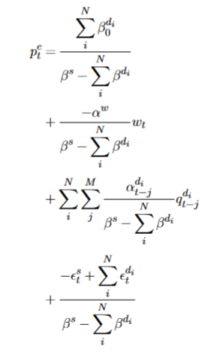
Model variations (all AR + price elastic)
Simple
Complex
Homogenous
Heterogenous, unobserved
Cross-price elasticities
demand
function
price @ equilibrium

Slide 43
$$w_{t−2}$$
$$w_{t−1}$$
$$w_{t}$$
$$p_{t−2}^{e}$$
$$p_{t−1}^{e}$$
$$p_{t}^{e}$$
$$w_{t−2}$$
$$w_{t−1}$$
$$w_{t}$$
$$p_{t−2}^{e}$$
$$p_{t−1}^{e}$$
$$p_{t}^{e}$$
$$q_{t−2}^{e}$$
$$q_{t−1}^{e}$$
$$q_{t}^{e}$$
$$q_{t−2}^{d_{1}}$$
$$q_{t−1}^{d_{1}}$$
$$q_{t}^{d_{1}}$$
$$q_{t−2}^{e}$$
$$q_{t−1}^{e}$$
$$q_{t}^{e}$$
$$q_{t−2}^{d_{1}}$$
$$q_{t−1}^{d_{1}}$$
$$q_{t}^{d_{1}}$$
$$w_{t−2}$$
$$w_{t−1}$$
$$w_{t}$$
$$w_{t−2}$$
$$w_{t−1}$$
$$w_{t}$$
$$p_{t−2}^{e}$$
$$p_{t−1}^{e}$$
$$p_{t}^{e}$$
$$p_{t−2}^{e}$$
$$p_{t−1}^{e}$$
$$p_{t}^{e}$$
$$q_{t−2}^{d_{1}}$$
$$q_{t−1}^{d_{1}}$$
$$q_{t}^{d_{1}}$$
$$q_{t−2}^{e}$$
$$q_{t−1}^{e}$$
$$q_{t}^{e}$$
$$q_{t−2}^{e}$$
$$q_{t−1}^{e}$$
$$q_{t}^{e}$$
$$q_{t−2}^{d_{1}}$$
$$q_{t−1}^{d_{1}}$$
$$q_{t}^{d_{1}}$$

Slide 44
Complex model
weather
conditions
$$wind$$
$$w_{1}$$
$$w_{2}$$
$$w_{3}$$
$$w_{t−2}$$
$$w_{t−1}$$
$$w_{t}$$
temper-ature
price
$$p_{t−2}^{e}$$
$$p_{t−1}^{e}$$
$$p_{t}^{e}$$
$$p_{t−2}^{e}$$
$$p_{t−1}^{e}$$
$$p_{t}^{e}$$
$$H_{t−2}$$
$$H_{t−1}$$
$$H_{t}$$
clowdiness
solar generation
irradiation
$$demand$$
$$q_{t−2}^{e}$$
$$q_{t−1}^{e}$$
$$q_{t}^{e}$$
$$q_{t−2}^{e}$$
$$q_{t−1}^{e}$$
$$q_{t}^{e}$$
demand for lighting

Slide 45
Complex model
weather
conditions
$$wind$$
$$w_{1}$$
$$w_{2}$$
$$w_{3}$$
$$w_{t−2}$$
$$w_{t−1}$$
$$w_{t}$$
temper-ature
price
$$p_{t−2}^{e}$$
$$p_{t−1}^{e}$$
$$p_{t}^{e}$$
$$p_{t−2}^{e}$$
$$p_{t−1}^{e}$$
$$p_{t}^{e}$$
$$H_{t−2}$$
$$H_{t−1}$$
$$H_{t}$$
clowdiness
solar generation
irradiation
$$demand$$
$$q_{t−2}^{e}$$
$$q_{t−1}^{e}$$
$$q_{t}^{e}$$
$$q_{t−2}^{e}$$
$$q_{t−1}^{e}$$
$$q_{t}^{e}$$
demand for lighting

Slide 46
Complex model
weather
conditions
$$wind$$
$$w_{1}$$
$$w_{2}$$
$$w_{3}$$
$$w_{t−2}$$
$$w_{t−1}$$
$$w_{t}$$
temper-ature
price
$$p_{t−2}^{e}$$
$$p_{t−1}^{e}$$
$$p_{t}^{e}$$
$$p_{t−2}^{e}$$
$$p_{t−1}^{e}$$
$$p_{t}^{e}$$
$$H_{t−2}$$
$$H_{t−1}$$
$$H_{t}$$
clowdiness
solar generation
irradiation
$$demand$$
$$q_{t−2}^{e}$$
$$q_{t−1}^{e}$$
$$q_{t}^{e}$$
$$q_{t−2}^{e}$$
$$q_{t−1}^{e}$$
$$q_{t}^{e}$$
demand for lighting

Slide 47
Complex model
weather
conditions
$$wind$$
$$w_{1}$$
$$w_{2}$$
$$w_{3}$$
$$w_{t−2}$$
$$w_{t−1}$$
$$w_{t}$$
temper-ature
price
$$p_{t−2}^{e}$$
$$p_{t−1}^{e}$$
$$p_{t}^{e}$$
$$p_{t−2}^{e}$$
$$p_{t−1}^{e}$$
$$p_{t}^{e}$$
$$H_{t−2}$$
$$H_{t−1}$$
$$H_{t}$$
clowdiness
solar generation
irradiation
$$demand$$
$$q_{t−2}^{e}$$
$$q_{t−1}^{e}$$
$$q_{t}^{e}$$
$$q_{t−2}^{e}$$
$$q_{t−1}^{e}$$
$$q_{t}^{e}$$
demand for lighting

Slide 48
Complex model
weather
conditions
$$wind$$
$$w_{1}$$
$$w_{2}$$
$$w_{3}$$
$$w_{t−2}$$
$$w_{t−1}$$
$$w_{t}$$
temper-ature
price
$$p_{t−2}^{e}$$
$$p_{t−1}^{e}$$
$$p_{t}^{e}$$
$$p_{t−2}^{e}$$
$$p_{t−1}^{e}$$
$$p_{t}^{e}$$
$$H_{t−2}$$
$$H_{t−1}$$
$$H_{t}$$
clowdiness
solar generation
irradiation
$$demand$$
$$q_{t−2}^{e}$$
$$q_{t−1}^{e}$$
$$q_{t}^{e}$$
$$q_{t−2}^{e}$$
$$q_{t−1}^{e}$$
$$q_{t}^{e}$$
demand for lighting

Slide 49
Complex model
weather
conditions
$$wind$$
$$w_{1}$$
$$w_{2}$$
$$w_{3}$$
$$w_{t−2}$$
$$w_{t−1}$$
$$w_{t}$$
temper-ature
price
$$p_{t−2}^{e}$$
$$p_{t−1}^{e}$$
$$p_{t}^{e}$$
$$p_{t−2}^{e}$$
$$p_{t−1}^{e}$$
$$p_{t}^{e}$$
$$H_{t−2}$$
$$H_{t−1}$$
$$H_{t}$$
clowdiness
solar generation
irradiation
$$demand$$
$$q_{t−2}^{e}$$
$$q_{t−1}^{e}$$
$$q_{t}^{e}$$
$$q_{t−2}^{e}$$
$$q_{t−1}^{e}$$
$$q_{t}^{e}$$
demand for lighting

Slide 50
Complex model
weather
conditions
$$wind$$
$$w_{t−2}$$
$$w_{t−1}$$
$$w_{t}$$
$$w_{t−2}$$
$$w_{t−1}$$
$$w_{t}$$
temper-ature
price
$$p_{t−2}^{e}$$
$$p_{t−1}^{e}$$
$$p_{t}^{e}$$
$$p_{t−2}^{e}$$
$$p_{t−1}^{e}$$
$$p_{t}^{e}$$
$$H_{t−2}$$
$$H_{t−1}$$
$$H_{t}$$
clowdiness
solar generation
irradiation
$$demand$$
$$q_{t−2}^{e}$$
$$q_{t−1}^{e}$$
$$q_{t}^{e}$$
$$q_{t−2}^{e}$$
$$q_{t−1}^{e}$$
$$q_{t}^{e}$$
demand for lighting

Slide 51
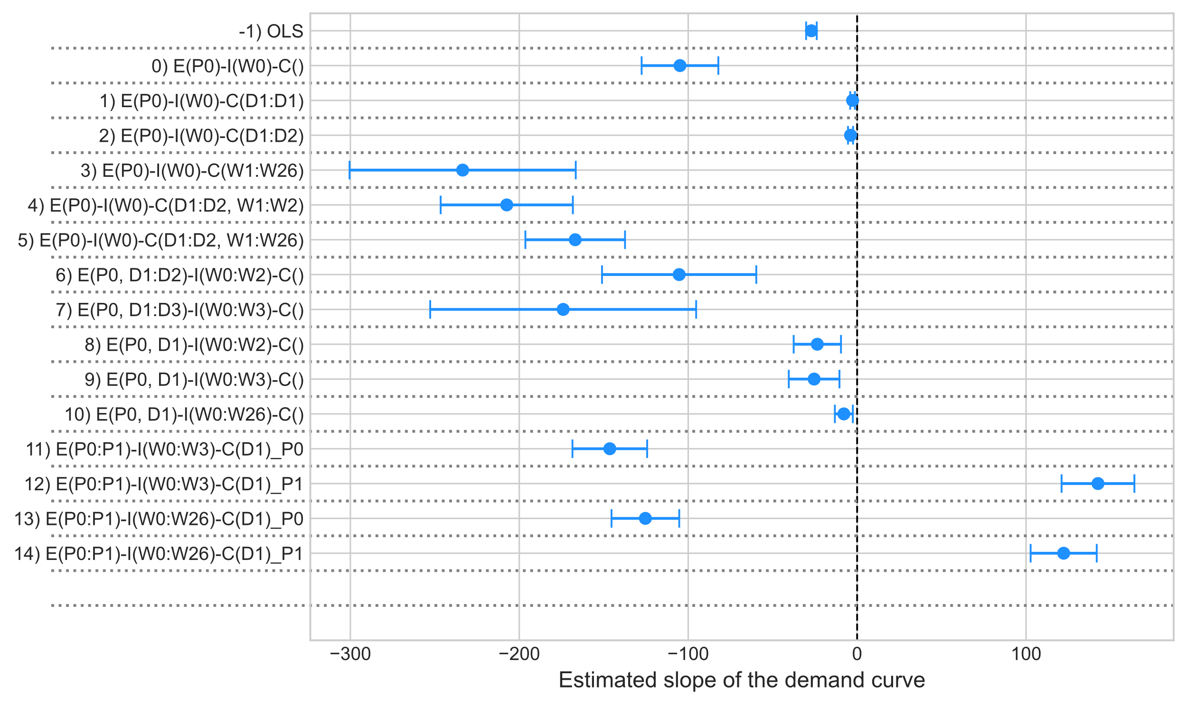
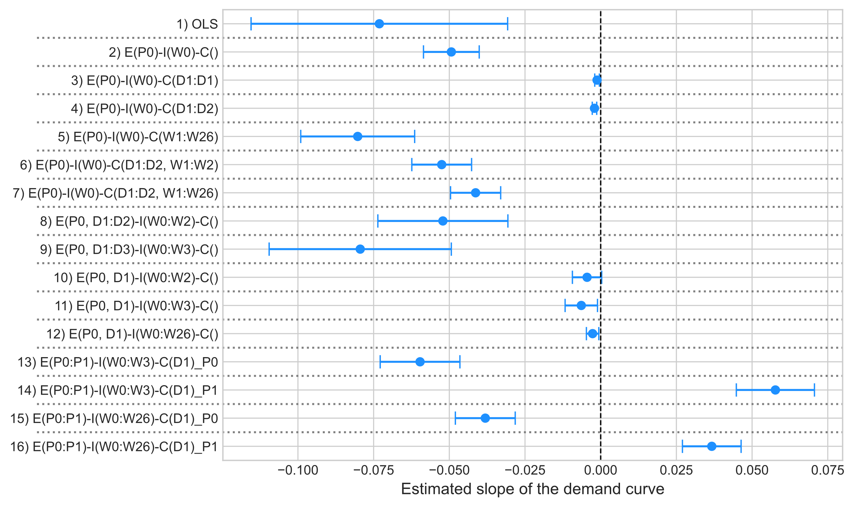
$$w_{t−2}$$
$$w_{t−1}$$
$$w_{t}$$
$$w_{t−2}$$
$$w_{t−1}$$
$$w_{t}$$
$$p_{t−2}^{e}$$
$$p_{t−1}^{e}$$
$$p_{t}^{e}$$
$$p_{t−2}^{e}$$
$$p_{t−1}^{e}$$
$$p_{t}^{e}$$
$$H_{t−2}$$
$$H_{t−1}$$
$$H_{t}$$
Linear
log-log
$$q_{t−2}^{e}$$
$$q_{t−1}^{e}$$
$$q_{t}^{e}$$
$$q_{t−2}^{e}$$
$$q_{t−1}^{e}$$
$$q_{t}^{e}$$

Slide 52
instrument
hourly electricity price
hourly electricity demand
price
demand
electricity zone
instrument
price
demand
daily electricty price
daily electricity demand

Slide 53
$$w_{t−2}$$
$$w_{t−1}$$
$$w_{t}$$
$$w_{t−2}$$
$$w_{t−1}$$
$$w_{t}$$
$$p_{t−2}^{e}$$
$$p_{t−1}^{e}$$
$$p_{t}^{e}$$
$$p_{t−2}^{e}$$
$$p_{t−1}^{e}$$
$$p_{t}^{e}$$
$$H_{t−2}$$
$$H_{t−1}$$
$$H_{t}$$
$$q_{t−2}^{e}$$
$$q_{t−1}^{e}$$
$$q_{t}^{e}$$
$$q_{t−2}^{e}$$
$$q_{t−1}^{e}$$
$$q_{t}^{e}$$

Slide 54
The simple model
W_{t-2}
W_{t-1}
W_{t}
Supply: $S_{t}^{}=β^{S}P_{t}+{α^{W}W}_{t}+ε_{t}^{s}$
Demand:
$D_{t}^{}=β^{own}P_{t}+α^{d}D_{t−1}+ε_{t}^{d}$
P _{t-2}
P _{t-1}
P _{t}
Demand:
$$D_{t}^{}=β^{own}P_{t}$$
D_{t-2}
D_{t-1}
D_{t}
$$S_{t}^{}=β^{S}P_{t}+{α^{W}W}_{t}$$
$$P_{t} \sim {α^{W}W}_{t}$$

Slide 55
Simple model
$$w_{t−2}$$
$$w_{t−1}$$
$$w_{t}$$
$$p_{t−2}^{e}$$
$$p_{t−1}^{e}$$
$$p_{t}^{e}$$
$$q_{t−2}^{e}$$
$$q_{t−1}^{e}$$
$$q_{t}^{e}$$

Slide 56
Complex model
a)
$$w_{t−2}$$
$$w_{t−1}$$
$$w_{t}$$
b)
$$w_{t−2}$$
$$w_{t−1}$$
$$w_{t}$$
c1)
$$w_{t−2}$$
$$w_{t−1}$$
$$w_{t}$$
$$p_{t−2}^{e}$$
$$p_{t−1}^{e}$$
$$p_{t}^{e}$$
$$p_{t−2}^{e}$$
$$p_{t−1}^{e}$$
$$p_{t}^{e}$$
$$p_{t−2}^{e}$$
$$p_{t−1}^{e}$$
$$p_{t}^{e}$$
$$q_{t−2}^{e}(i)$$
$$q_{t−1}^{e}(i)$$
$$q_{t}^{e}(i)$$
$$q_{t−2}^{e}$$
$$q_{t−1}^{e}$$
$$q_{t}^{e}$$
$$q_{t−2}^{e}$$
$$q_{t−1}^{e}$$
$$q_{t}^{e}$$
$$q_{t−2}^{e}$$
$$q_{t−1}^{e}$$
$$q_{t}^{e}$$
$$H_{t−2}$$
$$H_{t−1}$$
$$H_{t}$$
with $q_{t−j}^{e}=\sum_{i}^{N}{q_{t−j}^{e}}\left(i\right)$ for all i = 0, 1, 2, …, T and N = number of consumers
c2)
$$w_{t−2}$$
$$w_{t−1}$$
$$w_{t}$$
$$p_{t−2}^{e}$$
$$p_{t−1}^{e}$$
$$p_{t}^{e}$$
$$q_{t−2}^{e}$$
$$q_{t−1}^{e}$$
$$q_{t}^{e}$$

Slide 57
Complex model
$$w_{t−1}$$
$$w_{t}$$
$$p_{t−1}^{e}$$
$$p_{t}^{e}$$
$$w_{t−2}$$
$$w_{t−1}$$
$$w_{t}$$
$$w_{t−2}$$
$$w_{t−1}$$
$$w_{t}$$
$${Δ(p}_{t−1},p_{t})$$
$$p_{t−2}^{e}$$
$$p_{t−1}^{e}$$
$$p_{t}^{e}$$
$$p_{t−2}^{e}$$
$$p_{t−1}^{e}$$
$$p_{t}^{e}$$
$${Δ(d}_{t−1},d_{t})$$
$$H_{t−2}$$
$$H_{t−1}$$
$$H_{t}$$
$$d_{t−1}^{}$$
$$d_{t}^{}$$
$$q_{t−2}^{e}$$
$$q_{t−1}^{e}$$
$$q_{t}^{e}$$
$$q_{t−2}^{e}$$
$$q_{t−1}^{e}$$
$$q_{t}^{e}$$

Slide 58
The complex model
W_{t-2}
W_{t-1}
W_{t}
Supply: $S_{t}^{}=β^{S}P_{t}+{α^{W}W}_{t}+ε_{t}^{s}$
Demand:
$D_{t}^{}=β^{own}P_{t}+{β^{cross}P_{t−1}+H}_{t}+ε_{t}^{d}$
P _{t-2}
P _{t-1}
P _{t}
where: $H_{t}=α^{H}H_{t−1}+ε_{t}^{H}$
D_{t-2}
D_{t-1}
D_{t}
H_{t-2}
H_{t-1}
H_{t}
to be discussed: have we forgotten the organge path or is it in there „via“ D_t

Slide 59
The complex model/different arrangement
W_{t-2}
W_{t-1}
W_{t}
Supply: $S_{t}^{}=β^{S}P_{t}+{α^{W}W}_{t}+ε_{t}^{s}$
Demand:
$D_{t}^{}=β^{own}P_{t}+{β^{cross}P_{t−1}+H}_{t}+ε_{t}^{d}$
P _{t-2}
P _{t-1}
P _{t}
where: $H_{t}=α^{H}H_{t−1}+ε_{t}^{H}$
H_{t-2}
H_{t-1}
H_{t}
D_{t-2}
D_{t-1}
D_{t}
maybe a better arrangement

Slide 60
Why cross-price elasticities incorporated demand shifting/inertia of unobserved demand (shares)
the complex model
alternative resprentation with one demand being unobserved
W_{t-2}
W_{t-1}
W_{t}
W_{t-2}
W_{t-1}
W_{t}
Demand:
${D1}_{t}^{}=β^{own}P_{t}+{D1}_{t−1}+ε_{t}^{d}$
where: $D_{t}=D1_{t}+H_{t} and$
P _{t-2}
P _{t-1}
P _{t}
P _{t-2}
P _{t-1}
P _{t}
$$H_{t}=α^{H}H_{t−1}+ε_{t}^{H}$$
D1_{t-2}
D1_{t-1}
D1_{t}
D_{t-2}
D_{t-1}
D_{t}
D_{t-2}
D_{t-1}
D_{t}
H_{t-2}
H_{t-1}
H_{t}
H_{t-2}
H_{t-1}
H_{t}
check if all edges end at correct nodes, particularly yellow

Slide 61
DAG @ equilibrium
“In fact, it is not immediately obvious to me how one would capture supply and demand models in a DAG. [... A graph] capturing the simultaneity by having arrows go from prices to quantities and back [...] does not [...] really capture what is going on. It is not the case that there is an effect of prices on quantities [in equilibrium] that corresponds to the demand function and an effect from quantities to prices that captures supply. Rather, [...] the demand and supply functions are the primitives. Together they determine both equilibrium prices and quantities. The identification comes from the presence of observed demand and supply shifters. [...] It would also be helpful if the DAG researchers engaged more fully with such models where equilibrium plays a central role." (Imbens 2020, p. 1162-1163)
Imbens (2020)
Our model
z^{s}
c)
a)
b)
$$p^{e}$$
demand
$$p^{e}$$
q
p
$$x^{s}$$
$$q^{d}\left(⋅\right)$$
$$q^{s}\left(⋅\right)$$
x^{d}
x^{s}
x^{d}
x^{s}
$$ε^{d}$$
supply
$$x^{d}$$
$$q^{e}$$
$$q^{e}$$
d
s
x^{d}
x^{s}

Slide 62
a)
$$p^{e}$$
c)
$$p^{e}$$
w
x^{d}
x^{s}
x^{d}
$$\frac{∂q^{d}}{∂p}$$
x^{s}
$$q^{d}\left(⋅\right)$$
$$q^{s}\left(⋅\right)$$
$q^{d}\left(⋅\right)$| $\frac{∂q^{d}}{∂p}$
$$q^{s}\left(⋅\right)$$
$$q^{e}$$
$$q^{e}$$
b)
$$p^{e}$$
d)
$$p^{e}$$
w
x^{d}
$$\frac{∂q^{d}}{∂p}$$
x^{s}
x^{d}
$$\frac{∂p}{∂q^{d}}$$
x^{s}
$q^{d}\left(⋅\right)$| $\frac{∂q^{d}}{∂p}$
$$q^{s}\left(⋅\right)$$
$q^{d}\left(⋅\right)$| $\frac{∂p}{∂q^{d}}$
$$q^{s}\left(⋅\right)$$
$$q^{e}$$
$$q^{e}$$

Slide 63
DAG @ equilibrium
$$p^{e}$$
$$q^{d}\left(⋅\right)$$
$$q^{s}\left(⋅\right)$$
x^{d}
x^{s}
$$q^{e}$$
$$p^{e}$$
$$q^{d}\left(⋅\right)$$
$$q^{s}\left(⋅\right)$$
$$q^{e}$$
the demand function includes external factors; they are not external
the demand functions influence the equilibrium price, not the equilibrium price the demand functions, i.e. the direction of the edges needs to be changed
the instrument always influences both, the equilibrium quantity and the equilibrium price. it oculd thereofre be used to estimate the effect the equilibrium quantity on the equilibrium supply
and the equilibrium quantity
we need to define wheather we are intersted in estimating the effect of supply on demand or of demand on supply
if we define, which relationship we are intersted in, i.e. either the effect of the pe on qe or the effect of
an instrument that only influences supply, can either be represented as
fixing the effect of two observables is like „pulling out/conditioning“ on the effect, but this – in general – does not remove all directional edges
using an instrument that only reacts to

Slide 64
DAG @ equilibrium
$$p^{e}$$
$$p^{e}$$
$$q^{d}\left(⋅\right)$$
$$q^{s}\left(⋅\right)$$
$q^{d}\left(⋅\right)$ |$\frac{∂p}{∂q^{d}}$
x^{d}
x^{s}
$\frac{∂p}{∂q^{d}}$
$$q^{e}$$
$$q^{e}$$
$$p^{e}$$
$$q^{d}\left(⋅\right)$$
$$q^{s}\left(⋅\right)$$
$$q^{e}$$
the demand function includes external factors; they are not external
the demand functions influence the equilibrium price, not the equilibrium price the demand functions, i.e. the direction of the edges needs to be changed
the instrument always influences both, the equilibrium quantity and the equilibrium price. it oculd thereofre be used to estimate the effect the equilibrium quantity on the equilibrium supply
and the equilibrium quantity
we need to define wheather we are intersted in estimating the effect of supply on demand or of demand on supply
if we define, which relationship we are intersted in, i.e. either the effect of the pe on qe or the effect of
an instrument that only influences supply, can either be represented as
fixing the effect of two observables is like „pulling out/conditioning“ on the effect, but this – in general – does not remove all directional edges
using an instrument that only reacts to

Slide 65
DAG @ equilibrium
$$p^{e}$$
$$p^{e}$$
$$q^{d}\left(⋅\right)$$
$$q^{s}\left(⋅\right)$$
$q^{d}\left(⋅\right)$ | $\frac{∂q^{d}}{∂p}$, $\frac{∂p}{∂q^{d}}$
$q^{s}\left(⋅\right)$ | $\frac{∂q^{s}}{∂p}$, $\frac{∂p}{∂q^{s}}$
x^{d}
x^{s}
$$\frac{∂p}{∂q^{d}}$$
$$\frac{∂p}{∂q^{s}}$$
$$\frac{∂q^{d}}{∂p}$$
$$\frac{∂q^{s}}{∂p}$$
$$q^{e}$$
$$q^{e}$$
$$p^{e}$$
$$q^{d}\left(⋅\right)$$
$$q^{s}\left(⋅\right)$$
x^{d}
x^{s}
$$q^{e}$$
the demand function includes external factors; they are not external
the demand functions influence the equilibrium price, not the equilibrium price the demand functions, i.e. the direction of the edges needs to be changed
the instrument always influences both, the equilibrium quantity and the equilibrium price. it oculd thereofre be used to estimate the effect the equilibrium quantity on the equilibrium supply
and the equilibrium quantity
we need to define wheather we are intersted in estimating the effect of supply on demand or of demand on supply
if we define, which relationship we are intersted in, i.e. either the effect of the pe on qe or the effect of
an instrument that only influences supply, can either be represented as
fixing the effect of two observables is like „pulling out/conditioning“ on the effect, but this – in general – does not remove all directional edges
using an instrument that only reacts to

Slide 66
DAG @ equilibrium
$$p^{e}$$
$$p^{e}$$
$$q^{d}\left(⋅\right)$$
$$q^{s}\left(⋅\right)$$
$q^{d}\left(⋅\right)$ | $\frac{∂q^{d}}{∂p}$, $\frac{∂p}{∂q^{d}}$
$q^{s}\left(⋅\right)$ | $\frac{∂q^{s}}{∂p}$, $\frac{∂p}{∂q^{s}}$
x^{d}
x^{s}
$$\frac{∂p}{∂q^{d}}$$
$$\frac{∂p}{∂q^{s}}$$
$$\frac{∂q^{d}}{∂p}$$
$$\frac{∂q^{s}}{∂p}$$
$$q^{e}$$
$$q^{e}$$
$$p^{e}$$
$$p^{e}$$
$$q^{d}\left(⋅\right)$$
$$q^{s}\left(⋅\right)$$
$q^{d}\left(⋅\right)$ | $\frac{∂q^{d}}{∂p}$, $\frac{∂p}{∂q^{d}}$
$q^{s}\left(⋅\right)$ |z^{s}
$$\frac{∂p}{∂q^{d}}$$
$$\frac{∂q^{d}}{∂p}$$
$$q^{e}$$
$$q^{e}$$
the demand function includes external factors; they are not external
the demand functions influence the equilibrium price, not the equilibrium price the demand functions, i.e. the direction of the edges needs to be changed
the instrument always influences both, the equilibrium quantity and the equilibrium price. it oculd thereofre be used to estimate the effect the equilibrium quantity on the equilibrium supply
and the equilibrium quantity
we need to define wheather we are intersted in estimating the effect of supply on demand or of demand on supply
if we define, which relationship we are intersted in, i.e. either the effect of the pe on qe or the effect of
an instrument that only influences supply, can either be represented as
fixing the effect of two observables is like „pulling out/conditioning“ on the effect, but this – in general – does not remove all directional edges
using an instrument that only reacts to

Slide 67
DAG @ equilibrium
$$p^{e}$$
z^{s}
$$\frac{∂p}{∂q^{d}}$$
$q^{d}\left(⋅\right)$| $\frac{∂p}{∂q^{d}}$
$$q^{s}\left(⋅\right)$$
$$p^{e}$$
$$p^{e}$$
$$q^{e}$$
$$q^{d}\left(⋅\right)$$
$$q^{s}\left(⋅\right)$$
$q^{d}\left(⋅\right)$ | $\frac{∂q^{d}}{∂p}$, $\frac{∂p}{∂q^{d}}$
$q^{s}\left(⋅\right)$ | $\frac{∂q^{s}}{∂p}$, $\frac{∂p}{∂q^{s}}$
x^{d}
x^{s}
$$\frac{∂p}{∂q^{d}}$$
$$\frac{∂p}{∂q^{s}}$$
$$\frac{∂q^{d}}{∂p}$$
$$\frac{∂q^{s}}{∂p}$$
$$p^{e}$$
z^{s}
$$q^{e}$$
$$q^{e}$$
$$\frac{∂q^{d}}{∂p}$$
$q^{d}\left(⋅\right)$| $\frac{∂q^{d}}{∂p}$
$$q^{s}\left(⋅\right)$$
$$q^{e}$$
$$p^{e}$$
$$p^{e}$$
z^{s}
$$q^{d}\left(⋅\right)$$
$$q^{s}\left(⋅\right)$$
$q^{d}\left(⋅\right)$ | $\frac{∂q^{d}}{∂p}$, $\frac{∂p}{∂q^{d}}$
$q^{s}\left(⋅\right)|$z^{S} = z
$$\frac{∂p}{∂q^{d}}$$
$$\frac{∂q^{d}}{∂p}$$
$$p^{e}$$
z^{s}
$$q^{e}$$
$$q^{e}$$
$$p^{e}$$
$$\frac{∂q^{d}}{∂p}$$
$$x^{s}$$
$$q^{s}\left(⋅\right)$$
$q^{d}\left(⋅\right)$| $\frac{∂q^{d}}{∂p}$
$$q^{d}\left(⋅\right)\text{ |} \frac{∂q^{d}}{∂p}= ε^{d}$$
$$q^{e}$$
$$x^{d}$$
$$q^{e}$$
the demand function includes external factors; they are not external
the demand functions influence the equilibrium price, not the equilibrium price the demand functions, i.e. the direction of the edges needs to be changed
the instrument always influences both, the equilibrium quantity and the equilibrium price. it oculd thereofre be used to estimate the effect the equilibrium quantity on the equilibrium supply
and the equilibrium quantity
we need to define wheather we are intersted in estimating the effect of supply on demand or of demand on supply
if we define, which relationship we are intersted in, i.e. either the effect of the pe on qe or the effect of
an instrument that only influences supply, can either be represented as
fixing the effect of two observables is like „pulling out/conditioning“ on the effect, but this – in general – does not remove all directional edges
using an instrument that only reacts to

Slide 68
DAG @ equilibrium
$$p^{e}$$
z^{s}
$$\frac{∂p}{∂q^{d}}$$
$q^{d}\left(⋅\right)$| $\frac{∂p}{∂q^{d}}$
$$q^{s}\left(⋅\right)$$
$$p^{e}$$
$$p^{e}$$
$$q^{e}$$
$$q^{d}\left(⋅\right)$$
$$q^{s}\left(⋅\right)$$
$q^{d}\left(⋅\right)$ | $\frac{∂q^{d}}{∂p}$, $\frac{∂p}{∂q^{d}}$
$q^{s}\left(⋅\right)$ | $\frac{∂q^{s}}{∂p}$, $\frac{∂p}{∂q^{s}}$
x^{d}
x^{s}
$$\frac{∂p}{∂q^{d}}$$
$$\frac{∂p}{∂q^{s}}$$
$$\frac{∂q^{d}}{∂p}$$
$$\frac{∂q^{s}}{∂p}$$
$$q^{e}$$
$$q^{e}$$
$$p^{e}$$
$$p^{e}$$
$$q^{d}\left(⋅\right)$$
$$q^{s}\left(⋅\right)$$
$q^{d}\left(⋅\right)$ | $\frac{∂q^{d}}{∂p}$, $\frac{∂p}{∂q^{d}}$
$q^{s}\left(⋅\right)$ |z^{s}
$$\frac{∂p}{∂q^{d}}$$
$$\frac{∂q^{d}}{∂p}$$
$$q^{e}$$
$$q^{e}$$
the demand function includes external factors; they are not external
the demand functions influence the equilibrium price, not the equilibrium price the demand functions, i.e. the direction of the edges needs to be changed
the instrument always influences both, the equilibrium quantity and the equilibrium price. it oculd thereofre be used to estimate the effect the equilibrium quantity on the equilibrium supply
and the equilibrium quantity
we need to define wheather we are intersted in estimating the effect of supply on demand or of demand on supply
if we define, which relationship we are intersted in, i.e. either the effect of the pe on qe or the effect of
an instrument that only influences supply, can either be represented as
fixing the effect of two observables is like „pulling out/conditioning“ on the effect, but this – in general – does not remove all directional edges
using an instrument that only reacts to

Slide 69
DAG @ equilibrium
$$p^{e}$$
$q^{d}\left(⋅\right)$ | $\frac{∂q^{d}}{∂p}$, $\frac{∂p}{∂q^{d}}$
$q^{s}\left(⋅\right)$ | $\frac{∂q^{s}}{∂p}$, $\frac{∂p}{∂q^{s}}$
$$\frac{∂p}{∂q^{d}}$$
$$\frac{∂p}{∂q^{s}}$$
$$\frac{∂q^{d}}{∂p}$$
$$\frac{∂q^{s}}{∂p}$$
$$q^{e}$$
$$p^{e}$$
$$p^{e}$$
$$p^{e}$$
$$q^{s}\left(⋅\right)$$
$$q^{d}\left(⋅\right)$$
$q^{d}\left(⋅\right)$ | $\frac{∂q^{d}}{∂p}$, $\frac{∂p}{∂q^{d}}$
$q^{s}\left(⋅\right)$ |z^{s}
$$q^{d}\left(⋅\right)$$
$$q^{s}\left(⋅\right)$$
$$\frac{∂p}{∂q^{d}}$$
$$\frac{∂q^{d}}{∂p}$$
x^{d}
x^{s}
$$q^{e}$$
$$q^{e}$$
$$q^{e}$$
$$p^{e}$$
z^{s}
$$p^{e}$$
z^{s}
$$\frac{∂q^{d}}{∂p}$$
$$p^{e}$$
z^{s}
$$\frac{∂q^{d}}{∂p}$$
$q^{d}\left(⋅\right)$| $\frac{∂q^{d}}{∂p}$
$$q^{s}\left(⋅\right)$$
$q^{d}\left(⋅\right)$| $\frac{∂q^{d}}{∂p}$
$$q^{s}\left(⋅\right)$$
$$q^{e}$$
$$\frac{∂p}{∂q^{d}}$$
$$q^{e}$$
$q^{d}\left(⋅\right)$| $\frac{∂p}{∂q^{d}}$
$$q^{s}\left(⋅\right)$$
$$q^{e}$$
the demand function includes external factors; they are not external
the demand functions influence the equilibrium price, not the equilibrium price the demand functions, i.e. the direction of the edges needs to be changed
the instrument always influences both, the equilibrium quantity and the equilibrium price. it oculd thereofre be used to estimate the effect the equilibrium quantity on the equilibrium supply
and the equilibrium quantity
we need to define wheather we are intersted in estimating the effect of supply on demand or of demand on supply
if we define, which relationship we are intersted in, i.e. either the effect of the pe on qe or the effect of
an instrument that only influences supply, can either be represented as
fixing the effect of two observables is like „pulling out/conditioning“ on the effect, but this – in general – does not remove all directional edges
using an instrument that only reacts to

Slide 70
DAG @ equilibrium
$$p^{e}$$
$q^{d}\left(⋅\right)$ | $\frac{∂q^{d}}{∂p}$, $\frac{∂p}{∂q^{d}}$
$q^{s}\left(⋅\right)$ | $\frac{∂q^{s}}{∂p}$, $\frac{∂p}{∂q^{s}}$
$$\frac{∂p}{∂q^{d}}$$
$$\frac{∂p}{∂q^{s}}$$
$$\frac{∂q^{d}}{∂p}$$
$$\frac{∂q^{s}}{∂p}$$
$$q^{e}$$
$$p^{e}$$
$$p^{e}$$
$$p^{e}$$
$$q^{s}\left(⋅\right)$$
$$q^{d}\left(⋅\right)$$
$q^{d}\left(⋅\right)$ | $\frac{∂q^{d}}{∂p}$, $\frac{∂p}{∂q^{d}}$
$q^{s}\left(⋅\right)$ |z^{s}
$$q^{d}\left(⋅\right)$$
$$q^{s}\left(⋅\right)$$
$$\frac{∂p}{∂q^{d}}$$
$$\frac{∂q^{d}}{∂p}$$
x^{d}
x^{s}
$$q^{e}$$
$$q^{e}$$
$$q^{e}$$
$$p^{e}$$
z^{s}
$$p^{e}$$
z^{s}
$$\frac{∂q^{d}}{∂p}$$
$$p^{e}$$
z^{s}
$$\frac{∂q^{d}}{∂p}$$
$q^{d}\left(⋅\right)$| $\frac{∂q^{d}}{∂p}$
$$q^{s}\left(⋅\right)$$
$q^{d}\left(⋅\right)$| $\frac{∂q^{d}}{∂p}$
$$q^{s}\left(⋅\right)$$
$$q^{e}$$
$$\frac{∂p}{∂q^{d}}$$
$$q^{e}$$
$q^{d}\left(⋅\right)$| $\frac{∂p}{∂q^{d}}$
$$q^{s}\left(⋅\right)$$
$$q^{e}$$
the demand function includes external factors; they are not external
the demand functions influence the equilibrium price, not the equilibrium price the demand functions, i.e. the direction of the edges needs to be changed
the instrument always influences both, the equilibrium quantity and the equilibrium price. it oculd thereofre be used to estimate the effect the equilibrium quantity on the equilibrium supply
and the equilibrium quantity
we need to define wheather we are intersted in estimating the effect of supply on demand or of demand on supply
if we define, which relationship we are intersted in, i.e. either the effect of the pe on qe or the effect of
an instrument that only influences supply, can either be represented as
fixing the effect of two observables is like „pulling out/conditioning“ on the effect, but this – in general – does not remove all directional edges
using an instrument that only reacts to

Slide 71
DAG @ equilibrium
$$p^{e}$$
$q^{d}\left(⋅\right)$ | $\frac{∂q^{d}}{∂p}$, $\frac{∂p}{∂q^{d}}$
$q^{s}\left(⋅\right)$ | $\frac{∂q^{s}}{∂p}$, $\frac{∂p}{∂q^{s}}$
$$\frac{∂p}{∂q^{d}}$$
$$\frac{∂p}{∂q^{s}}$$
$$\frac{∂q^{d}}{∂p}$$
$$\frac{∂q^{s}}{∂p}$$
$$q^{e}$$
$$p^{e}$$
$$p^{e}$$
$$p^{e}$$
$$q^{s}\left(⋅\right)$$
$$q^{d}\left(⋅\right)$$
$q^{d}\left(⋅\right)$ | $\frac{∂q^{d}}{∂p}$, $\frac{∂p}{∂q^{d}}$
$q^{s}\left(⋅\right)$ |z^{s}
$$q^{d}\left(⋅\right)$$
$$q^{s}\left(⋅\right)$$
$$\frac{∂p}{∂q^{d}}$$
$$\frac{∂q^{d}}{∂p}$$
x^{d}
x^{s}
$$q^{e}$$
$$q^{e}$$
$$q^{e}$$
$$p^{e}$$
z^{s}
$$p^{e}$$
z^{s}
$$\frac{∂q^{d}}{∂p}$$
$$p^{e}$$
z^{s}
$$\frac{∂q^{d}}{∂p}$$
$q^{d}\left(⋅\right)$| $\frac{∂q^{d}}{∂p}$
$$q^{s}\left(⋅\right)$$
$q^{d}\left(⋅\right)$| $\frac{∂q^{d}}{∂p}$
$$q^{s}\left(⋅\right)$$
$$q^{e}$$
$$\frac{∂p}{∂q^{d}}$$
$$q^{e}$$
$q^{d}\left(⋅\right)$| $\frac{∂p}{∂q^{d}}$
$$q^{s}\left(⋅\right)$$
$$q^{e}$$
the demand function includes external factors; they are not external
the demand functions influence the equilibrium price, not the equilibrium price the demand functions, i.e. the direction of the edges needs to be changed
the instrument always influences both, the equilibrium quantity and the equilibrium price. it oculd thereofre be used to estimate the effect the equilibrium quantity on the equilibrium supply
and the equilibrium quantity
we need to define wheather we are intersted in estimating the effect of supply on demand or of demand on supply
if we define, which relationship we are intersted in, i.e. either the effect of the pe on qe or the effect of
an instrument that only influences supply, can either be represented as
fixing the effect of two observables is like „pulling out/conditioning“ on the effect, but this – in general – does not remove all directional edges
using an instrument that only reacts to

Slide 72
old, currently re-running a version with cross-rpice elasticitiy and without autocorrelation of D1 to be the most similar to our complex model. should be ready tomorrow

Slide 73
Including control sets
W_{t-2}
W_{t-1}
W_{t}
T _{t-1}
T _{t-1}
T _{t}
S _{t}
S _{t}
S _{t}
P _{t-2}
P _{t-1}
P _{t}
H _{t-1}
H _{t-1}
H _{t}
DI_{t-2}
DI_{t-1}
DI_{t}
D_{t-2}
D_{t-1}
D_{t}
DH_{t-2}
DH_{t-1}
DH_{t}

